Slide 2


Collective effects in Beam Dynamics
Giovanni Rumolo, Hannes Bartosik and Kevin Li
USPAS, one-week course, 19-24 January, 2015
http://uspas.fnal.gov/index.shtml

Slide 3
Outline
Introduction
  Collective effects
  Transverse single particle dynamics including systems of many non-interacting particles
  Longitudinal single particle dynamics including systems of many non-interacting particles

Slide 4
Introduction
In this lecture we will treat the transverse motion of beam particles
We focus on circular machines (in fact synchrotrons)
In the course of this lecture series we will encounter several examples of collective effects observed in the CERN accelerator complex
  Proton Synchrotron Booster (PSB)
  Proton Synchrotron (PS)
  Super Proton Synchrotron (SPS)
  Large Hadron Collider (LHC)

Slide 5
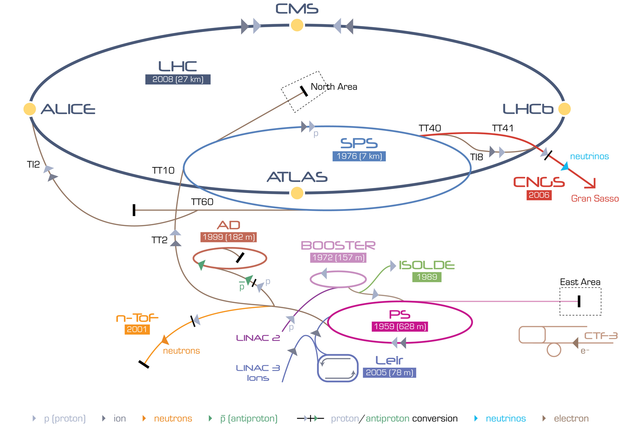
CERN accelerator complex
450 GeV → 7 TeV
26 GeV → 450 GeV
50 MeV → 1.4 GeV
1.4 GeV → 26 GeV

Slide 6
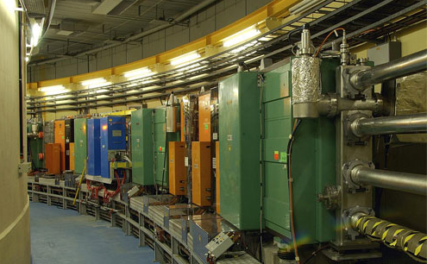
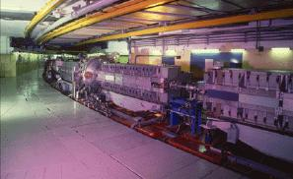
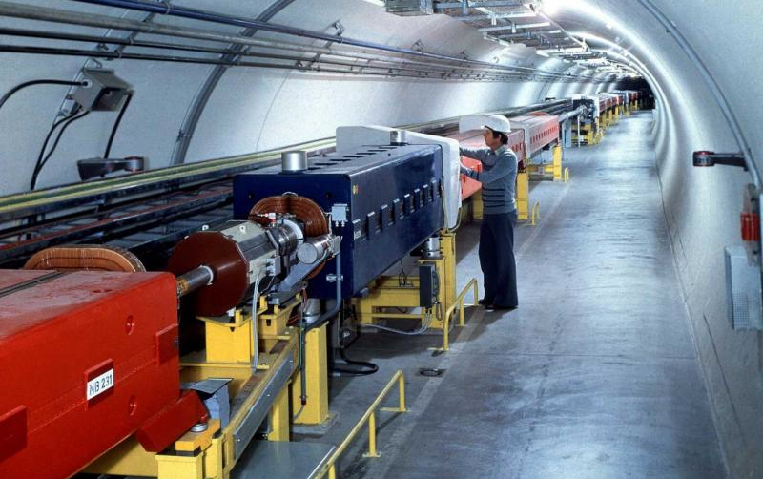
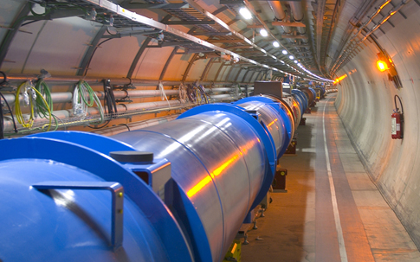
The CERN machines
PSB
PS
SPS
LHC

Slide 7
What is a synchrotron?
Dipole magnets to bend the beam on the circular orbit
Quadrupole magnets to focus the beam
Radio Frequency (RF) cavity to accelerate the beam
Lorentz force
Motion of single particle is described by
Main characteristics of synchrotrons
  Use electric fields to accelerate and magnetic fields to guide particles
  Design orbit is fixed at a given radius independent of the beam energy (magnetic field is increased proportional to momentum)
  Beam is accelerated during many revolutions passing through the same RF cavity
  Accelerating RF is synchronized with particle revolution frequency → “Synchrotron”

Slide 8
Coordinate system
We use a co-moving coordinate system to describe the particle motion around the reference orbit
  The origin O is moving along with “synchronous particle”, i.e. a reference particle that has the design momentum and follows the design orbit
  Mean radius R is defined through machine circumference C = 2π R
  Transverse coordinates x and y relative to reference particle (where x,y << R)
  Longitudinal coordinate z relative to reference particle
  Position along accelerator is described by independent variable s = vt

Slide 9
Dipole magnets – beam guidance
S
y
ρ
N
dipole magnets: uniform magnetic field in y direction
In a uniform magnetic field B, a particle with charge e, velocity v, rest mass m and Lorentz factor γ follows a circular trajectory with bending radius ρ
The magnetic field of dipole magnets in a synchrotron defines
  the reference trajectory (orbit) around the machine
  the reference momentum (through the magnetic rigidity)
Lorentz force
Centrifugal force
magnetic rigidity

Slide 10
Dipole magnets – weak focusing
Consider a particle with initial offset from reference orbit in a uniform magnetic field in y direction
The particle performs a harmonic oscillation with frequency ω
This is the weak focusing in horizontal plane:
y
x₀
s = vt
particle with initial offset
ρ
reference orbit

Slide 11
Quadrupole magnets – strong focusing
S
N
F_{y}
x
y
F_{x}
s
N
S
“focusing”
quadrupole
“defocusing”
quadrupole
“focusing”
quadrupole
“defocusing”
quadrupole
x
Magnetic field proportional to offset results in linear restoring force
Force is focusing in one plane while defocusing in the other → need to alternate between focusing and defocusing quadrupoles (“alternating gradient lattice”) to achieve overall focusing in a particle accelerator or transfer line
In accelerator design we use the normalized quadrupole strength
x
s

Slide 12
Equations of motion
Consider linear fields (dipoles + quadrupoles) and on-momentum particles
Linear equations with s-dependent coefficients
  equivalent to harmonic oscillator with s-dependent dependent frequency
  in a ring (or transport line with symmetries), the focusing terms are periodic:
Not straightforward to derive analytical solutions for whole accelerator …
quadrupoles
dipoles (“weak focusing”)
Hill’s equations
can be written as:

Slide 13
Element-wise solution of Hill’s equations
Consider a part of the accelerator where focusing term is constant: K=K₀
This is the equation of a harmonic oscillator with the element-wise solutions
In general the solution can be written in matrix form
… u stands for x or y
… u(0) and u’(0) are the initial conditions
for K₀ > 0 (focusing)
where
for K₀ = 0 (drift)
for K₀ < 0 (defocusing)

Slide 14
Transfer matrix formalism
The general transfer matrix from location s₀ to s is written as
The transport through an accelerator or transfer line can be described by a series of matrix multiplications
s₀
s₁
s₂
s₃
s₄
s₅
…
s
from s₀ to s₁
from s₀ to s₂
from s₀ to s_{n}

Slide 15
General solution of Hill’s equation
The general solution of Hill’s equations (“betatron motion”) can be written as
  The beta function is defined by the envelope equation (follows from Hill’s equation)
  The “action” J_{u} is a constant of motion (i.e. independent of s)
“Twiss” parameters at s
Betatron phase

Slide 16
Phase space ellipse
u'
turn 1
turn 7
turn 8
turn 6
turn 2
u
turn 5
turn 3
turn 4
The phase space coordinates (u, u’) of a single particle at a given location s in the machine lie on the phase space ellipse when plotted for several turns.
The values of the Twiss parameters and therefore the orientation of the phase space ellipse depend on the s location in the machine. The phase space area enclosed by the ellipse is invariant and equal to 2J_{u}π.
The Twiss parameters are periodic with the machine circumference. Their values are derived from the transfer matrix and they are uniquely defined at any point in the machine.

Slide 17
General transfer matrix
From the general solutions for u and u’ we can write
The general transfer matrix from location s₀=0 to s is obtained as
Note: for a given part of the accelerator, this general transfer matrix based on beta functions is equivalent to the transfer matrix written in terms of K(s) obtained earlier from the multiplication of element wise solutions
… betatron phase advance

Slide 18
Periodic transfer matrix
Now we consider a periodic structure, in particular the transfer matrix for a full machine circumference C
  the optics functions must be periodic and are therefore uniquely defined!
  The phase advance over one turn is usually expressed as the betatron tune Q_{u}, which corresponds to the number of betatron oscillations per turn
The one turn transfer matrix is obtained as

Slide 19
Smooth approximation
An estimation of the average beta function from the betatron tune (or conversely an estimation of the tune from the average beta function) for an accelerator with radius R can be obtained by:
Corresponds to a uniform focusing channel and is often used for quick calculations and in particular for the theoretical treatment of transverse beam instabilities. Since the betatron tune indicates the number of transverse oscillations per turn, the Hill’s equation in smooth approximation can also be written as

Slide 20
Example: FODO cell
defocusing quadrupole
focusing quadrupole
focusing quadrupole
bending magnet
bending magnet

Slide 21
Example: lattice of the SPS

Slide 22
Off-momentum particles – dispersion
Consider a particle having a momentum error Δp w.r.t. the reference particle
In a dipole magnet, off momentum particles have a different bending angle and thus receive a different deflection compared to the reference particle. Off-momentum particles therefore follow a different closed orbit along the machine.
The equation of motion in the horizontal plane becomes
Solution is sum of homogeneous and inhomogeneous part
Inserting x(s) into equation of motion yields
trajectory of off-momentum particle
solution of
particular solution
with “dispersion” D_{x}
design
orbit
D_{x}(s)*Δp/p defines the closed orbit for off-momentum particles

Slide 23
Momentum compaction
The closed orbit for an individual particle depends on its momentum offset with respect to the reference particle
To the lowest order in δ, the change of the circumference is given by
The momentum compaction factor α₀ relates the relative change of the circumference to the relative momentum change
The momentum compaction factor plays a central role for the longitudinal beam dynamics (see Kevin’s lecture)
in a FODO lattice

Slide 24
Off-momentum particles – chromaticity
Chromaticity is the dependence of the betatron tune on the relative momentum offset of a particle
Chromaticity plays a fundamental role for transverse instabilities
  In many cases chromaticity needs to be adjusted → this can be done by sextupole magnets installed in locations with non-zero dispersion
relative momentum offset
chromaticity
x
s
change of focusing strength for particles with different momenta
focusing error is prop. to relative momentum offset
natural chromaticity is always < 0

Slide 25
Betatron detuning with amplitude
Up to now we considered only linear magnetic fields (dipoles, quadrupoles) in the equations of motion
In a real accelerator there are also non-linear fields (from sextupoles for chromaticity correction, from magnetic field imperfections, …)
  In the presence of non-linear magnetic fields, the betatron tune Q_{u} depends on the betatron amplitude (action) J_{u}
  To the first order in J_{u} the detuning with amplitude can be written as
  Octupole magnets induce first order detuning with amplitude in leading order and can thus be used to adjust the anharmonicities
In some cases detuning with amplitude is generated on purpose in order to fight instabilities (e.g. in the LHC) …
“anharmonicities”

Slide 26
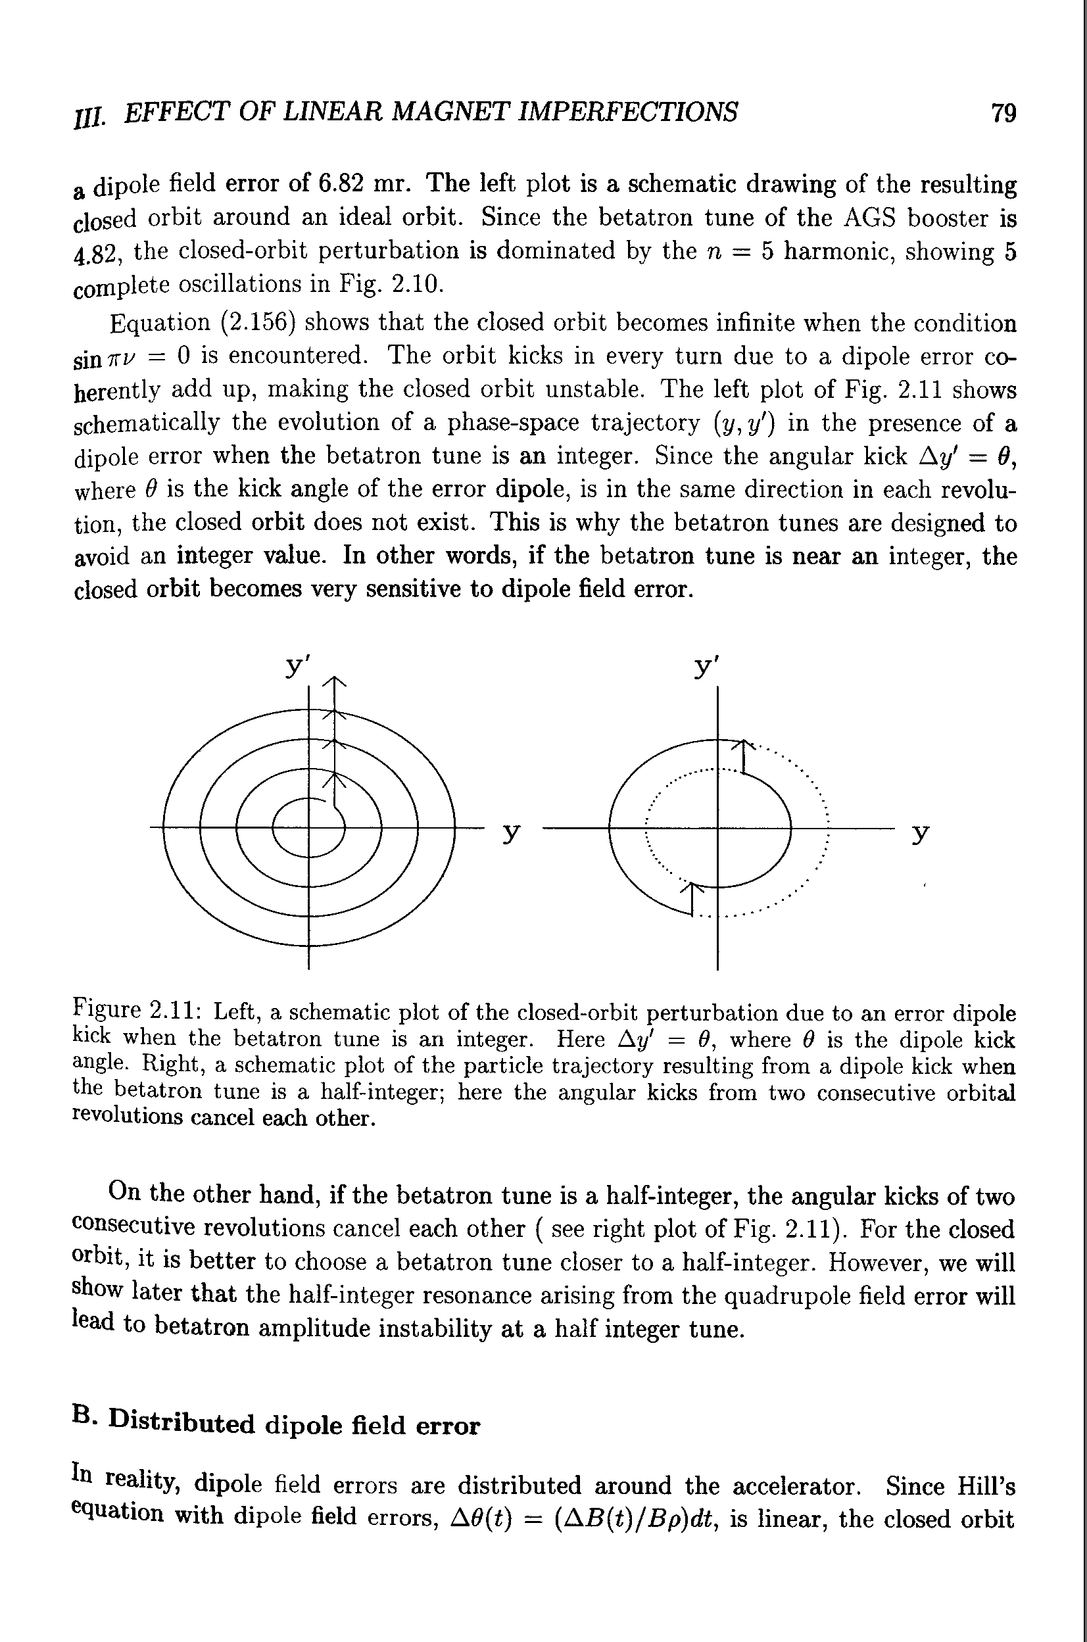
Resonances
In the presence of optical machine imperfections the values of the betatron tunes should not be on or close to a rational fraction
  Dipole errors deflect a particle each turn in phase if tune is an integer N
Effect of dipole error in phase space
Q = N
dipole kicks add up
Q = N/2
cancellation after two turns
closed orbit instability

Slide 27
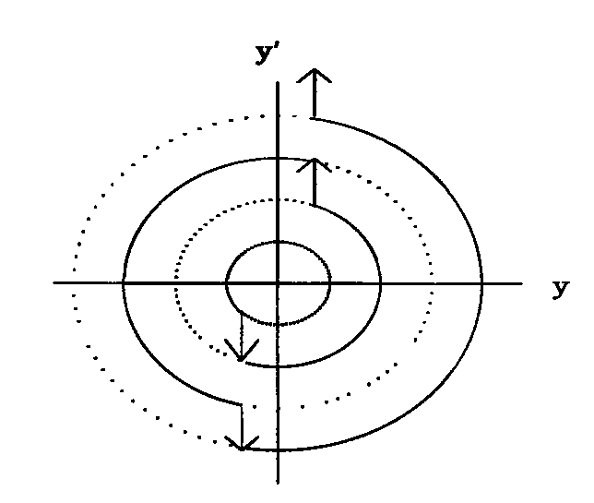
Resonances
In the presence of optical machine imperfections the values of the betatron tunes should not be on or close to a rational fraction
  Dipole errors deflect a particle each turn in phase if tune is an integer N
  Quadrupole errors are in phase if tune is an integer N or a half integer N+1/2
Effect of quadrupole error in phase space
Q = N
quadrupole kicks add up
Q = N/2
quadrupole kicks add up
beam size grows each turn

Slide 28
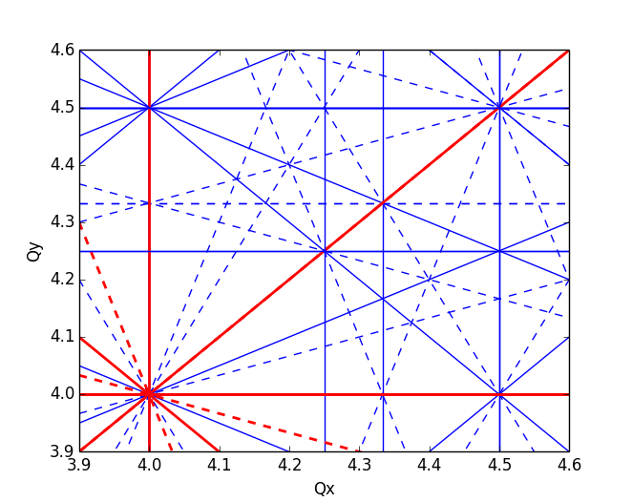
Resonances
In the presence of optical machine imperfections the values of the betatron tunes should not be on or close to a rational fraction
  Dipole errors deflect a particle each turn in phase if tune is an integer N
  Quadrupole errors are in phase if tune is an integer N or a half integer N+1/2
  The 2 dimensional resonance condition is
for k, l, m integers
order of the resonance
The tune diagram shows the resonance lines where the betatron motion can be unstable (here up to 4th order)
Usually the strength of the resonance decreases as the resonance order increases
The “working point” corresponds to the tunes of the machine (as defined by the focusing)

Slide 29
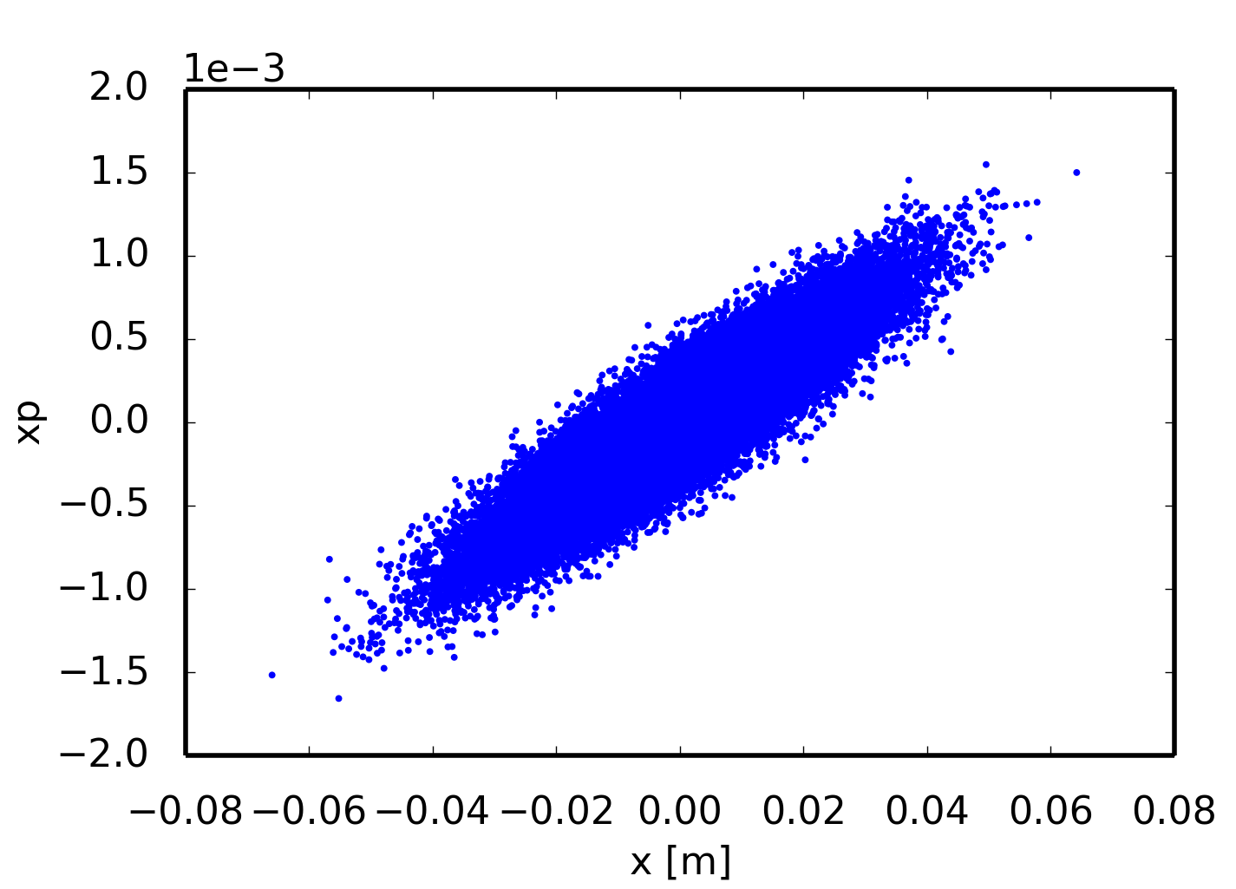
Particle ensemble
Up to now we were looking at individual particles …
Let’s have a look at a beam consisting of N particles which are described by a particle distribution function
statistical moments of the distribution

Slide 30
Transverse emittance
The beam size in the u-u’ phase space is usually quantified by the rms statistical emittance (also called geometrical emittance)
  The transverse momentum in the accelerator is given by
  The Liouville theorem states that volumes in the canonical phase space u – p_{u} are invariant if their evolution is governed by a Hamiltonian (like beam transport through an accelerator) → therefore the geometrical emittance (defined in the u-u’ phase space) shrinks during acceleration (“adiabatic damping”)
We define the normalized emittance, which is independent of beam energy
However there are effects that can lead to emittance blow-up, such as scattering effects, filamentation due to non-linearities, wake fields, space charge effects, …

Slide 31
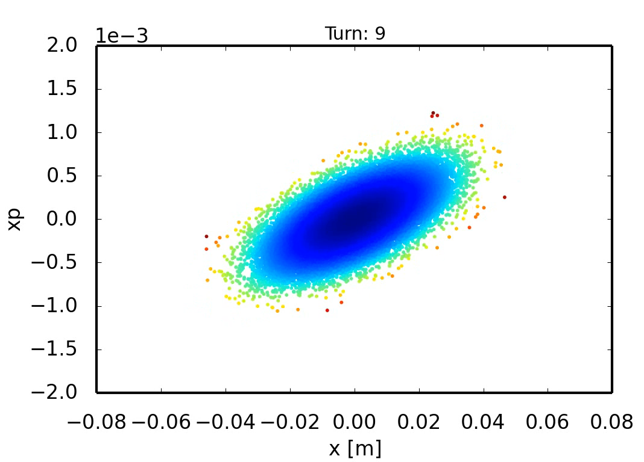
Transverse phase space matching
We can calculate the statistical TWISS parameters of a beam like
A beam is matched to the optics at the injection point of a machine means that the TWISS parameters of the beam are the same as the one of the machine
  If the beam is matched, the shape of the particle distribution remains stationary from turn to turn
matched
Notes:
Show the twiss parameters of the beam and only the matched beam case

Slide 32
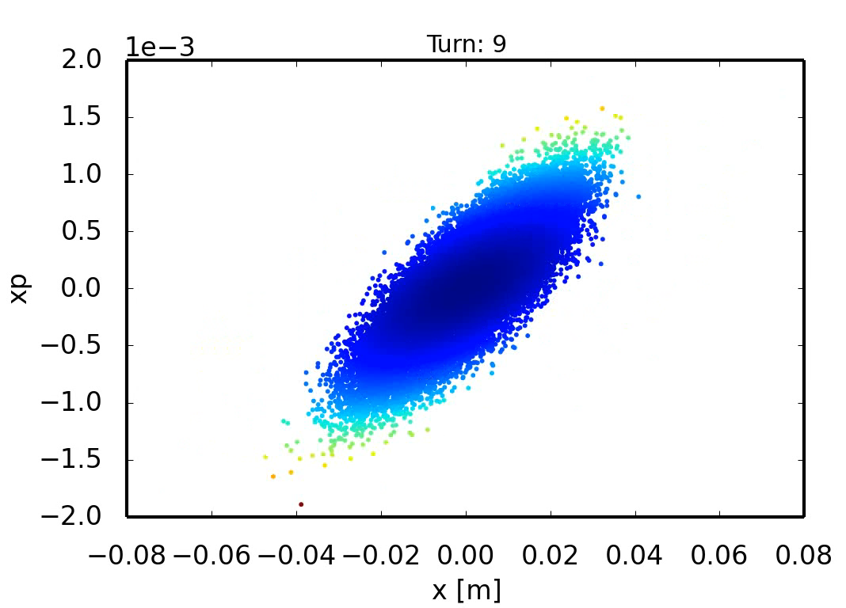
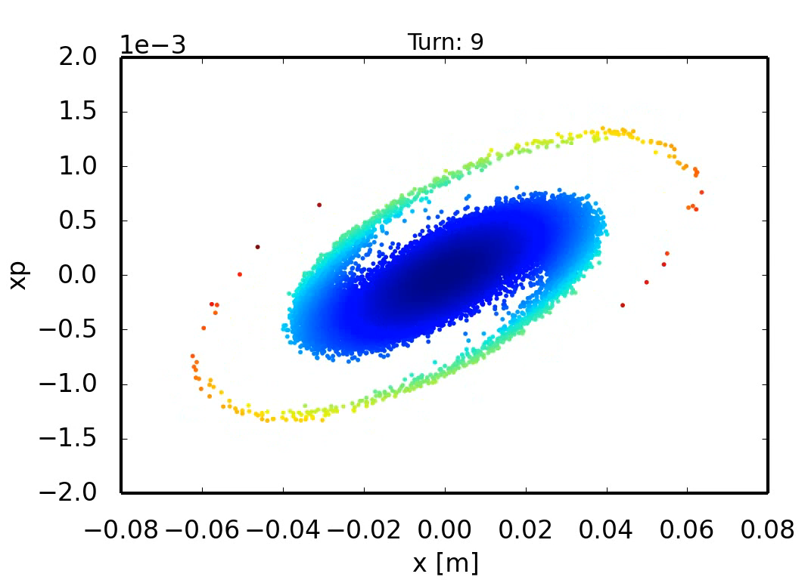
Filamentation
Injecting a mismatched beam results in quadrupole oscillations, i.e. the shape of the particle distribution will change from turn to turn
  In a linear lattice (with zero chromaticity), all particles have the same tune → the bunch will perform quadrupole oscillations but the emittance is preserved
  In a non-linear lattice, the tune of a particle depends on its betatron amplitude → the result is a dilution of the phase space area covered by the particle distribution, i.e. the emittance grows and the beam quality is degraded
mismatched – linear lattice
mismatched – nonlinear lattice
Notes:
Comparison of linear and non-linear lattice

Slide 33
Summary
The linear transverse particle motion is described by Hill’s equations
  The beam transport around the accelerator can be represented by “transfer” matrices
  The number of oscillations around the closed orbit is called betatron tune Q
  The particle motion is described by a pseudo-harmonic oscillation with varying amplitude (beta-function) and phase (betatron phase advance)
  In general the beam envelope (beam size) is varying around the machine
  The smooth approximation assumes a uniform focusing force around the accelerator
Off momentum particles follow a different closed orbit (dispersion) and can have a different tune in case the chromaticity is not corrected (using sextupoles)
Non-linear elements (e.g. octupoles) introduce betatron detuning with amplitude
To avoid beam envelope oscillations and emittance growth (in case of non-linear magnetic elements), the beam distribution has to be matched to the machine optics at the injection point

