Slide 2


Collective effects in Beam Dynamics
Giovanni Rumolo, Hannes Bartosik and Kevin Li
USPAS, one-week course, 19-24 January, 2015
http://uspas.fnal.gov/index.shtml

Slide 3
Outline
Introductory concepts
  Collective effects
  Transverse single particle dynamics including systems of many non-interacting particles
  Longitudinal single particle dynamics including systems of many non-interacting particles
Space charge
  Direct space charge (transverse)
  Indirect space charge (transverse)
  Longitudinal space charge

Slide 4
Outline
Wake fields and impedance
  Wake fields and wake function
  Definition of beam coupling impedance
  Examples – resonators and resistive wall
  Energy loss
  Impedance model of a machine

Slide 5
Introduction to the general problem
Multi-bunch beam
s
Equations of motion of the beam particles
Interaction with the external environment
Additional electromagnetic field acting on the beam, besides RF and external magnetic fields

Slide 6
Introduction to the general problem
Multi-bunch beam
s
Noise
Equations of motion of the beam particles
Interaction with the external environment
Additional electromagnetic field acting on the beam, besides RF and external magnetic fields
When the loop closes, either the beam will find a new stable equilibrium configuration …

Slide 7
Introduction to the general problem
Multi-bunch beam
s
Noise
Equations of motion of the beam particles
Interaction with the external environment
Additional electromagnetic field acting on the beam, besides RF and external magnetic fields
… or it might develop an instability along the bunch train …

Slide 8
Introduction to the general problem
Multi-bunch beam
s
Noise
Equations of motion of the beam particles
Interaction with the external environment
Additional electromagnetic field acting on the beam, besides RF and external magnetic fields
… or also an instability affecting different bunches independently of each other

Slide 9
Introduction to the general problem
Interaction of the beam with the external environment
Beam self-fields
  Set of Maxwell’s equations with
    The beam as the source term
    Boundary conditions given by the accelerator component in which the beam propagates
Fields from another beam
  Set of Maxwell’s equations with
    The other beam as the source term
    Boundary conditions given by the chamber in which the encounter between the beams takes place
The electron/ion cloud
  Electron/ion production and accumulation
  Poisson’s equation with
    The electron cloud as the source term
    Boundary conditions given by the chamber in which the electron cloud builds up
Additional electromagnetic field acting on the beam, besides RF and external magnetic fields

Slide 10
Introduction to the general problem
Interaction of the beam with the external environment
Beam self-fields
  Set of Maxwell’s equations with
    The beam as the source term
    Boundary conditions given by the accelerator component in which the beam propagates
Need of a mathematical framework to describe the effects of the self-induced fields on the beam
Time domain: Wake fields
Frequency domain: Beam coupling impedances

Slide 11
General concept of wake field
Source, q₁
Witness, q₂
2b
s
  A charge q₁δ(s-ct) traveling down a pipe with finite conductivity induces delayed currents in the wall and a trailing electromagnetic field

Slide 12
General concept of wake field
Source, q₁
Witness, q₂
2b
z
s
L
  A charge q₁δ(s-ct) traveling down a pipe with finite conductivity induces delayed currents in the wall and a trailing electromagnetic field
    A witness charge q₂δ(s-ct-z) at a distance z from the source feels the effect of this electromagnetic field
    Due to translational symmetry, the field acting on the witness only depends on z, and not on s and t separately
    The force all along a certain length of the structure, L (which will define the wake function associated to the the length L of beam chamber) is constant
  In general, all electromagnetic boundary conditions other than PEC, but also geometric discontinuities, are the origin of wake fields.

Slide 13
General concept of wake field
Source, q₁
Witness, q₂
2b
z
z
z
L
  While source and witness, distant by z<0, move in a perfectly conducting chamber, the witness does not feel any force (γ >> 1)
  When the source encounters a discontinuity (e.g., transition, device), the new electromagnetic field configuration that satisfies the boundary conditions will trail behind (wake field) and can ring for long if modes are trapped in the structure and losses are low
    The source loses energy upon crossing the discontinuity
    The witness feels a net force all along an effective length of the structure, L

Slide 14
Longitudinal wake function
L
Source, q₁
Witness, q₂
Δx₁ (or Δy₁)
2b
z
Δx₂ (or Δy₂)
Since there is no translational symmetry, the force on the witness charge depends on both s and t, or its distance z to the source (and source and witness positions):
But we can still integrate this force along the path where E_{s} ≠ 0 and get rid of the s dependence

Slide 15
Longitudinal wake function
Source, q₁
L
Witness, q₂
Δx₁ (or Δy₁)
2b
z
Δx₂ (or Δy₂)
In the special case of a segment of length L of resistive beam chamber
And the integration simply yields

Slide 16
Longitudinal wake function
L
Source, q₁
Witness, q₂
Δx₁ (or Δy₁)
2b
z
Δx₂ (or Δy₂)

Slide 17
Longitudinal wake function
L
Source, q₁
Witness, q₂
Δx₁ (or Δy₁)
2b
z
Δx₂ (or Δy₂)
If the impedance source has left/right top/bottom symmetry
Order zero: source and test centered. Usually dominant
Second order terms. Negligible for small offsets

Slide 18
Longitudinal wake function
L
Source, q₁
Witness, q₂
Δx₁ (or Δy₁)
2b
z
Δx₂ (or Δy₂)

Slide 19
Longitudinal wake function
  The value of the wake function in 0, W||(0), is related to the energy lost by the source particle in the creation of the wake
  W||(0)>0 since ΔE₁<0
  W||(0⁻)>0 since the longitudinal electric field must be retarding immediately following the source, regardless of any boundary conditions
  W||(z) is discontinuous in z=0 and it vanishes for all z>0 because of the ultra-relativistic approximation
W||(z)
Beam loading theorem
z

Slide 20
Longitudinal impedance
  The wake function of an accelerator component is basically its Green function in time domain (i.e., its response to a pulse excitation)
    Very useful for macroparticle models and simulations, because it can be used to describe the driving terms in the single particle equations of motion!
  We can also describe it as a transfer function in frequency domain
  This is the definition of longitudinal beam coupling impedance of the element under study
[Ω]
[Ω/s]

Slide 21
The energy balance
What happens to the energy lost by the source?
  In the global energy balance, the energy lost by the source splits into
    Electromagnetic energy of the modes that remain trapped in the object
      Partly dissipated on lossy walls or into purposely designed inserts or HOM absorbers
      Partly transferred to following particles (or the same particle over successive turns), possibly feeding into an instability!
    Electromagnetic energy of modes that propagate down the beam chamber (above cut-off), eventually lost on surrounding lossy materials

Slide 22
The energy balance
What happens to the energy lost by the source?
  In the global energy balance, the energy lost by the source splits into
    Electromagnetic energy of the modes that remain trapped in the object
      Partly dissipated on lossy walls or into purposely designed inserts or HOM absorbers
      Partly transferred to following particles (or the same particle over successive turns), possibly feeding into an instability!
    Electromagnetic energy of modes that propagate down the beam chamber (above cut-off), eventually lost on surrounding lossy materials
  The energy loss of a particle bunch
    Causes beam induced heating of the machine elements (damage, outgassing)
    Is compensated by the RF system determining a stable phase shift
    Feeds into both longitudinal and transverse instabilities through the associated EM fields

Slide 23
Transverse wake function
L
Source, q₁
Witness, q₂
Δx₁ (or Δy₁)
2b
z
Δx₂ (or Δy₂)
Also in the transverse plane, the force on the witness charge depends on both s and t, or its distance z to the source (and source and witness positions):
If we neglect the contributions v_{x}B_{s} and v_{y}B_{s} (v_{x,y}<<v_{s})

Slide 24
Transverse wake function
L
Source, q₁
Witness, q₂
Δx₁ (or Δy₁)
2b
z
Δx₂ (or Δy₂)
Also in the transverse plane, the force on the witness charge depends on both s and t, or its distance z to the source (and source and witness positions):
We can also integrate this force along the path where F_{x,y} ≠ 0 and get rid of the s dependence

Slide 25
Transverse wake function
Source, q₁
L
Witness, q₂
Δx₁ (or Δy₁)
2b
z
Δx₂ (or Δy₂)
In the special case of a segment of length L of resistive beam chamber
And the integration simply yields

Slide 26
Transverse wake function
L
Source, q₁
Witness, q₂
Δx₁ (or Δy₁)
2b
z
Δx₂ (or Δy₂)

Slide 27
Transverse wake function
L
Source, q₁
Witness, q₂
Δx₁ (or Δy₁)
2b
z
Δx₂ (or Δy₂)
Quadrupolar wakes, express relation to the offset of the test
If the impedance source has left/right top/bottom symmetry
Dipolar wakes, express relation to the offset of the source

Slide 28
Transverse wake function
L
Source, q₁
Witness, q₂
Δx₁ (or Δy₁)
2b
z
Δx₂ (or Δy₂)
  We have truncated to the first order, thus neglecting
    First order coupling terms between x and y planes
    All higher order terms in the wake expansion (including mixed higher order terms with products of the dipolar/quadrupolar offsets)
Quadrupolar wakes, express relation to the offset of the test
If the impedance source has left/right top/bottom symmetry
Dipolar wakes, express relation to the offset of the source

Slide 29
Transverse wake function: dipolar
L
Source, q₁
Witness, q₂
Δx₁ (or Δy₁)
2b
z

Slide 30
Transverse wake function: dipolar
  The value of the transverse dipolar wake functions in 0, W_{x,y}(0), vanishes because source and witness particles are traveling parallel and they can only – mutually – interact through space charge, which is not included in this framework
  W_{x,y}(0⁻⁻)<0 since trailing particles are deflected toward the source particle (Δx₁ and Δx’₂ have the same sign)

Slide 31
Transverse wake function: dipolar
  The value of the transverse dipolar wake functions in 0, W_{x,y}(0), vanishes because source and witness particles are traveling parallel and they can only – mutually – interact through space charge, which is not included in this framework
  W_{x,y}(0⁻⁻)<0 since trailing particles are deflected toward the source particle (Δx₁ and Δx’₂ have the same sign)
  W_{x,y}(z) has a discontinuous derivative in z=0 and it vanishes for all z>0 because of the ultra-relativistic approximation
W_{x,y}(z)
z

Slide 32
Transverse wake function: quadrupolar
L
Source, q₁
Witness, q₂
2b
z
Δx₂ (or Δy₂)

Slide 33
Transverse wake function: quadrupolar
  The value of the transverse quadrupolar wake functions in 0, W_{Qx,y}(0), vanishes because source and witness particles are traveling parallel and they can only – mutually – interact through space charge, which is not included in this framework
  W_{Qx,y}(0⁻⁻) can be of either sign since trailing particles can be either attracted or deflected even more off axis (depends on geometry and boundary conditions)

Slide 34
Transverse impedances
  The value of the transverse quadrupolar wake functions in 0, W_{Qx,y}(0), vanishes because source and witness particles are traveling parallel and they can only – mutually – interact through space charge, which is not included in this framework
  W_{Qx,y}(0⁻⁻) can be of either sign since trailing particles can be either attracted or deflected even more off axis (depends on geometry and boundary conditions)
  W_{x,y}(z) has a discontinuous derivative in z=0 and it vanishes for all z>0 because of the ultra-relativistic approximation
W_{Qx,y}(z)
z

Slide 35
Transverse wake function
L
Source, q₁
Witness, q₂
Δx₁ (or Δy₁)
2b
z
Δx₂ (or Δy₂)
Dipolar
Quadrupolar
[Ω/m]

Slide 36
Relation between transverse and longitudinal wakes (Panofsky-Wenzel theorem)
Source terms (displaced point charge traveling along s with speed v) in Cartesian coordinates:

Slide 37
Relation between transverse and longitudinal wakes (Panofsky-Wenzel theorem)
Source terms (displaced point charge traveling along s with speed v) in cylindrical coordinates:

Slide 38
Relation between transverse and longitudinal wakes (Panofsky-Wenzel theorem)

Slide 39
Relation between transverse and longitudinal wakes (Panofsky-Wenzel theorem)
We want to find relations between the forces on the witness charge:
with

Slide 40
Relation between transverse and longitudinal wakes (Panofsky-Wenzel theorem)
We first use this set of equations

Slide 41
Relation between transverse and longitudinal wakes (Panofsky-Wenzel theorem)
Result known as Panofsky-Wenzel theorem

Slide 42
Relation between transverse and longitudinal wakes (Panofsky-Wenzel theorem)

Slide 43
Relation between transverse and longitudinal wakes (Panofsky-Wenzel theorem)
The longitudinal and transverse wake functions are not independent, although in general no relation can be established between W||(z) and W_{x,y}(z), which are the main wakes in the longitudinal and transverse planes, respectively.

Slide 44
Relation between transverse and longitudinal wakes (Panofsky-Wenzel theorem)
We can now use also these two sets of equations to find additional properties of the wakes

Slide 45
Relation between transverse and longitudinal wakes (Panofsky-Wenzel theorem)
This is an interesting result!
The quadrupolar wakes in x and y must be equal with opposite signs
This relation means that the cross-wakes between x and y must be equal.
We have so far ignored these terms in our derivations.

Slide 46
How are wakes and impedances computed?
  Analytical or semi-analytical approach, when geometry is simple (or simplified)
    Solve Maxwell’s equations with the correct source terms, geometries and boundary conditions up to an advanced stage (e.g. resistive wall for axisymmetric chambers)
    Find closed expressions or execute the last steps numerically to derive wakes and impedances
  Numerical approach
    Different codes have been developed over the years to solve numerically Maxwell’s equations in arbitrarily complicated structures
    Examples are CST Studio Suite (Particle Studio, Microwave Studio), ABCI, GdFidL, HFSS, ECHO2(3)D. Exhaustive list can be found from the program of the ICFA mini-Workshop on “Electromagnetic wake fields and impedances in particle accelerators”, Erice, Sicily, 23-28 April, 2014
  Bench measurements based on transmission/reflection measurements with stretched wires
    Seldom used independently to assess impedances, usefulness mainly lies in that they can be used for validating 3D EM models for simulations

Slide 47
Examples of wakes/impedances
Resistive wall of beam chamber
  The case of a conductive pipe with an arbitrary number of layers with specified EM properties can be solved semi-analytically
  Layers sometimes required for impedance, but also for other reasons (e.g. coating against electron cloud or for good vacuum)
b
L = 1 m

Slide 48
Examples of wakes/impedances
Resistive wall of beam chamber
Source terms (displaced point charge traveling along s with speed v) in cylindrical coordinates and frequency domain:

Slide 49
Examples of wakes/impedances
Resistive wall of beam chamber
Source terms (displaced point charge traveling along s with speed v) in cylindrical coordinates and frequency domain:
Expansion in longitudinal modes
Expansion in azimuthal modes

Slide 50
Examples of wakes/impedances
Resistive wall of beam chamber
Maxwell’s equations combine into the wave equations:
We can seek solutions as expansions of longitudinal and azimuthal modes (for both E and B)

Slide 51
Examples of wakes/impedances
Resistive wall of beam chamber
Since we are interested in the force on the test charge, we can apply Panofsky-Wenzel and find out that we only need E_{s}:

Slide 52
Examples of wakes/impedances
Resistive wall of beam chamber

Slide 53
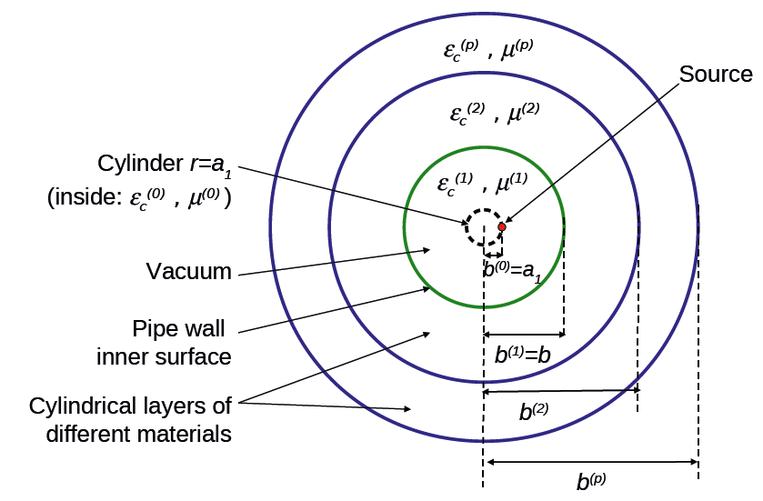
Examples of wakes/impedances
Resistive wall of beam chamber
The equations for the coefficients of the azimuthal modes of E_{s} must be solved in all the media and the conservation of the tangential components of the fields is applied at the boundaries between different layers
➔ E.g. ImpedanceWake2D code calculates impedances and then wakes. It can also deal with flat structures
r₁
=r₁

Slide 54
Examples of wakes/impedances
Resistive wall of beam chamber
  An interesting example: a 1 m long Cu pipe with radius b=2 cm and thickness t = 4mm in vacuum
b
t

Slide 55
Examples of wakes/impedances
Resistive wall of beam chamber
b
t
3 frequency regions of interest:
Below 0.1 kHz, impedance is basically purely imaginary, EM field is shielded by image charges → Indirect space charge

Slide 56
Examples of wakes/impedances
Resistive wall of beam chamber
b
t
3 frequency regions of interest:
Between 10 kHz and 1 THz, the EM field is fully attenuated in the Cu layer and the impedance is like the one calculated assuming infinitely thick wall

Slide 57
Examples of wakes/impedances
Resistive wall of beam chamber
b
t
3 frequency regions of interest:
Between 10 kHz and 1 THz, the EM field is fully attenuated in the Cu layer and the impedance is like the one calculated assuming infinitely thick wall

Slide 58
Examples of wakes/impedances
Resistive wall of beam chamber
b
t
3 frequency regions of interest:
Above 1 THz, there is a resonance (100 THz region). In this region also ac conductivity should be taken into account

Slide 59
Examples of wakes/impedances
Resistive wall of beam chamber
b
Correspondingly, in time domain, the wake exhibits different behaviours in short and long range
t
Medium-long range
Short range
In the range of tenths of ns up to fractions of ms (e.g. bunch length to several turns for the SPS) monotonically decaying wake
From behind the source to ~1ps the wake has an oscillatory behaviour, associated to the high frequency resonance

Slide 60
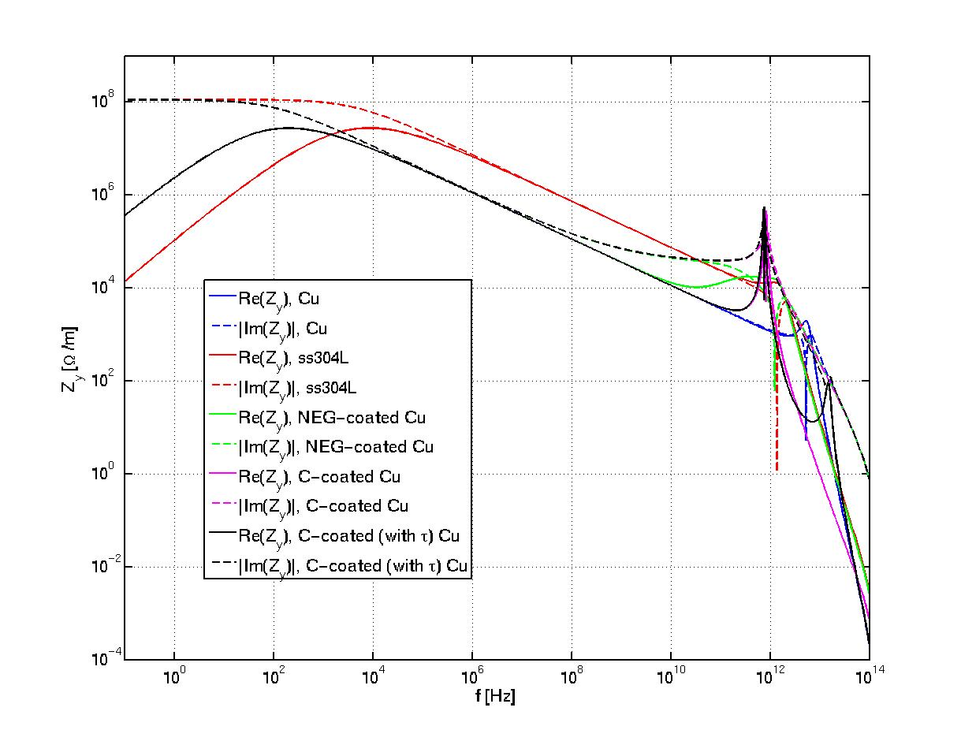
Examples of wakes/impedances
Resistive wall of beam chamber
  Another interesting example: 1 m long Cu (or StSt) pipe with radius b=9 mm coated with a layer of thickness t = 1μm of NEG or amorphous carbon (a-C)
b

Slide 61
Examples of wakes/impedances
Resistive wall of beam chamber
b
Below 10 GHz, coating is transparent. Impedance of StSt is about 7 times larger than that of Cu due to its conductivity about 50 times lower

Slide 62
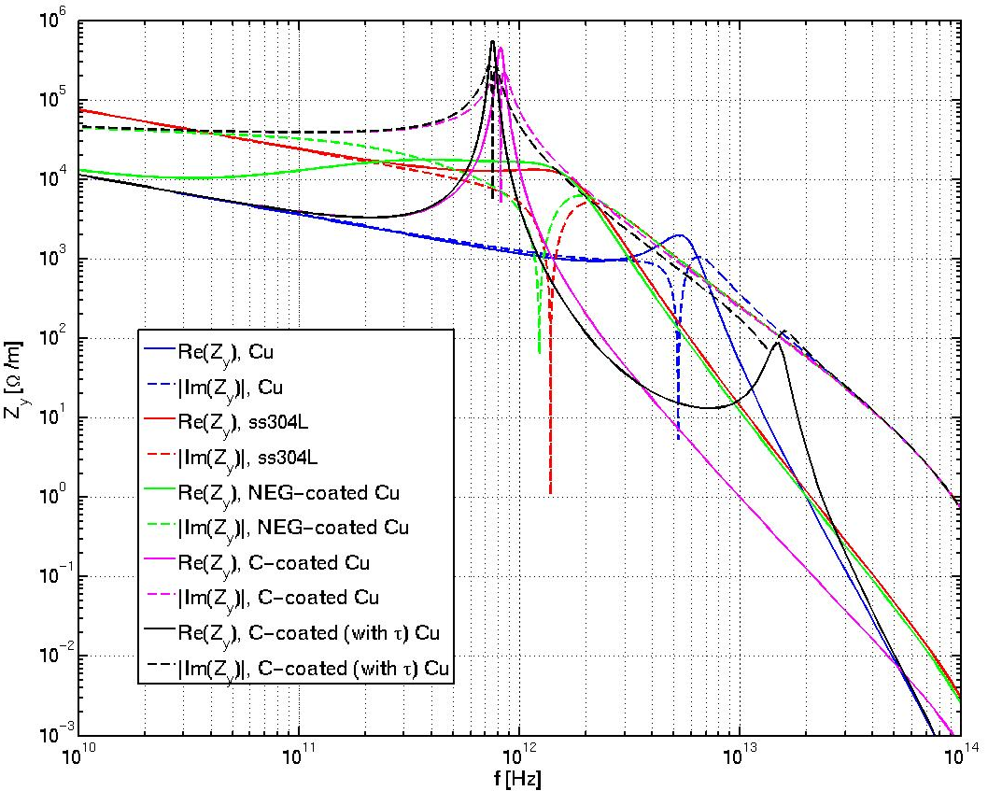
Examples of wakes/impedances
Resistive wall of beam chamber
b
Peak of NEG coated Cu is about the same as StSt (NEG and StSt have about same value of conductivity)
a-C causes the Cu peak to lower frequency and makes it more pronounced.
If ac conductivity included in a-C there is another peak at higher frequency

Slide 63
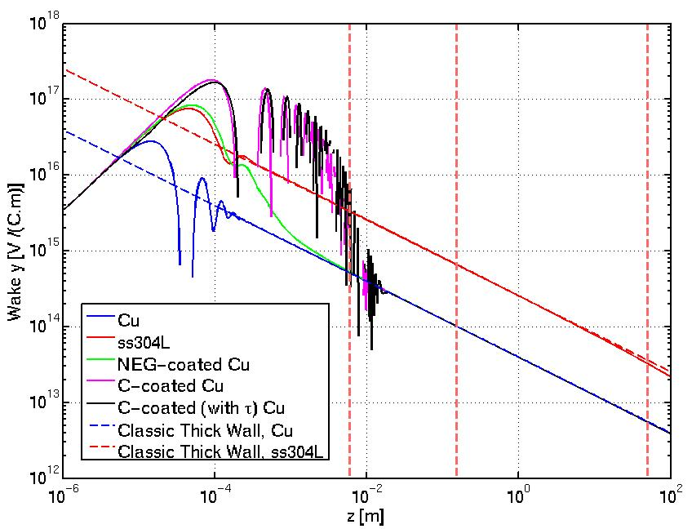
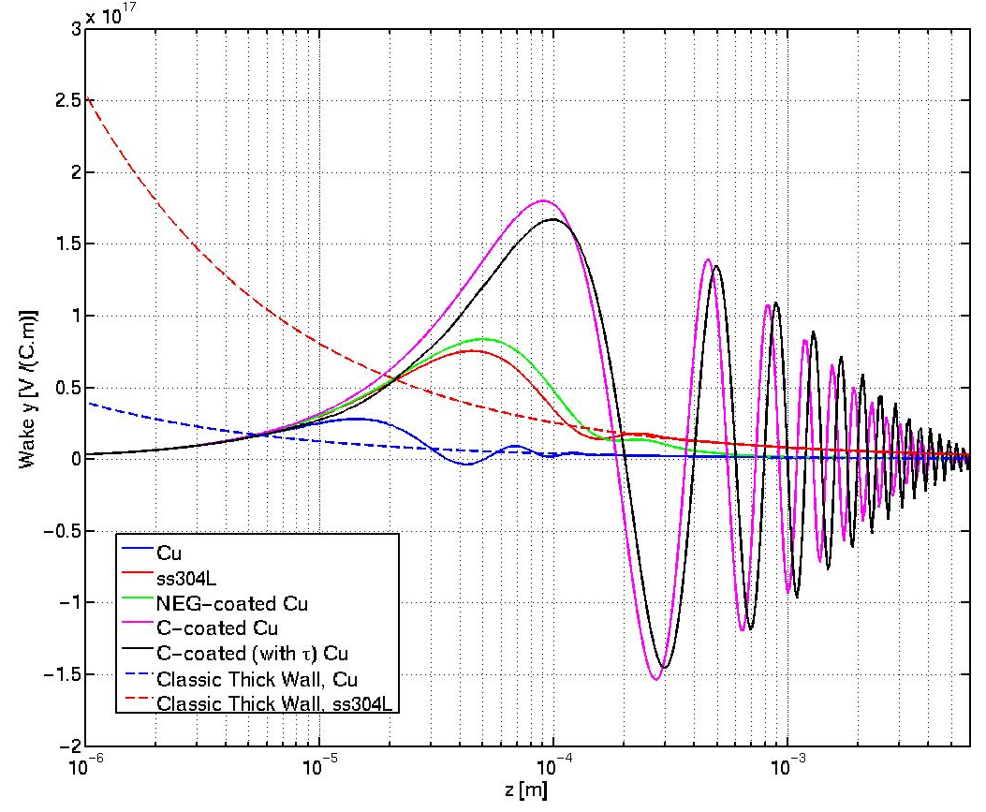
Examples of wakes/impedances
Resistive wall of beam chamber
b
Correspondingly, in time domain, the wake exhibits different behaviours for the different cases only in the short range
(plots with z positive to use the log scale)

Slide 64
Examples of wakes/impedances
Equations for infinitely thick wall
valid only in the range
b
with
valid in the corresponding range of frequencies

Slide 65
Examples of wakes/impedances
Equations for infinitely thick wall
b
b
a

Slide 66
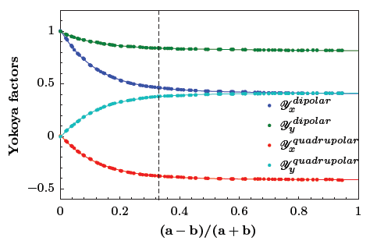
Examples of wakes/impedances
Equations for infinitely thick wall
b
b
a
Y^{longitudinal} ≈ 1
Y_{y}^{dipolar}
Y_{x}^{dipolar}
Y_{y}^{quadrupolar}
Y_{y}^{quadrupolar}

Slide 67
Examples of wakes/impedances
Longitudinal narrow band resonator
All cavity-like objects behave like one or more narrow band resonators, as a charged particle is likely to excite modes that keep ringing also after the particle has gone
W||
Re[Z||]
Im[Z||]
ω_{r}
T=2π/ω_{r}
  The frequency ω_{r} is related to the oscillation of E_{z}, and therefore to the frequency of the mode excited in the object
  The decay time depends on whether modes are excited and how quickly the stored energy in these modes is dissipated (quantified by a quality factor Q)

Slide 68
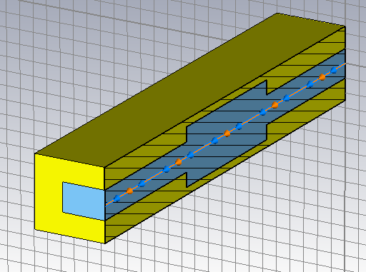
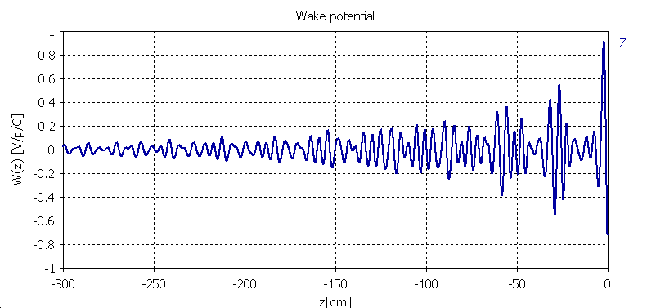
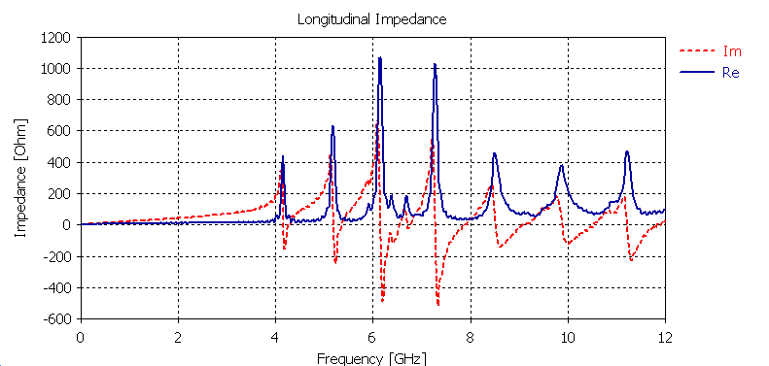
Examples of wakes/impedances
Single cell cavity
  A more complex example: a simple pill-box cavity with walls having finite conductivity
  Several modes can be excited
    Below the pipe cut-off frequency the width of the peaks is only determined by the finite conductivity of the walls
    Above, losses also come from propagation in the chamber
Longitudinal wake
Longitudinal impedance
Re[Z||]
Im[Z||]
Note W||(0)<0, CST uses opposite convention!!

Slide 69
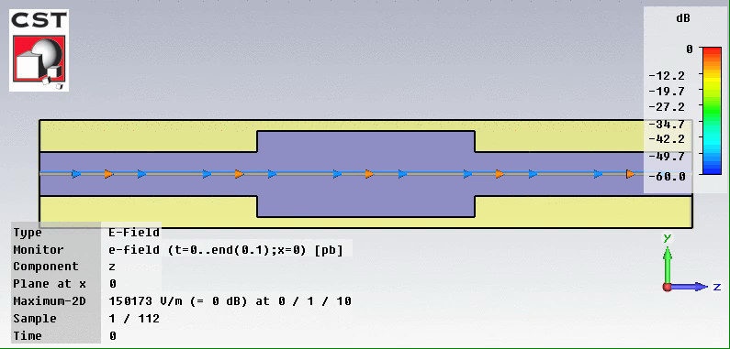
Examples of wakes/impedances
Single cell cavity
  Evolution of the the longitudinal electric field (E_{z}) in the cavity while and after the beam has passed

Slide 70
Examples of wakes/impedances
Longitudinal broad band resonator
Objects whose geometry makes it unlikely for a charged particle to excite modes exhibit fast decaying wakes, associated to a broad frequency coverage
W||
Re[Z||]
Im[Z||]
  In most cases, impedances of devices can be modeled as the sum of several narrow- and broad-band resonator peaks
  Other contributors to the global impedance can also have different shapes, e.g. the resistive wall

Slide 71
Examples of wakes/impedances
Transverse resonator
Re[Z_{x,y}]
Im[Z_{x,y}]
  Shape of wake function can be similar to that in longitudinal plane, determined by the oscillation period of the trailing electromagnetic fields
  Contrary to longitudinal impedances, Re[Z_{x,y}] is an odd function of frequency, while Im[Z_{x,y}] is an even function

Slide 72
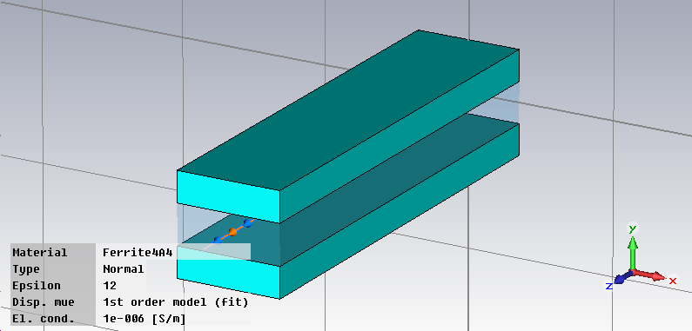
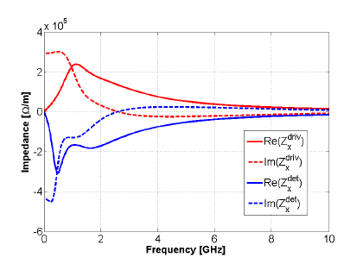
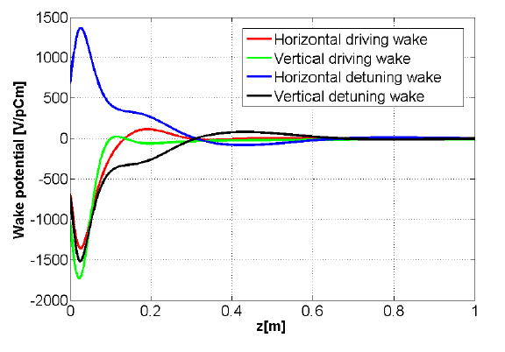
Examples of wakes/impedances
Ferrite kicker: simple model
  An example: magnetic kickers are usually large contributors to the transverse impedance of a machine
  It is a broad band contribution
    No trapped modes
    Losses both in vacuum chamber and ferrite (kicker heating and outgassing)
Horizontal impedance
N.B. In this plot the z-axis has been reversed

Slide 73
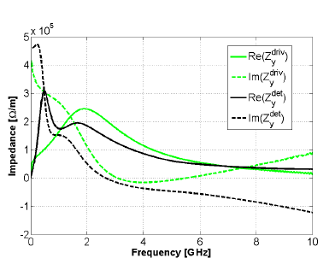
Examples of wakes/impedances
Ferrite kicker: simple model
  An example: magnetic kickers are usually large contributors to the transverse impedance of a machine
  It is a broad band contribution
    No trapped modes
    Losses both in vacuum chamber and ferrite (kicker heating and outgassing)
Vertical impedance
N.B. In this plot the z-axis has been reversed
In the EM simulation wakes do not go to zero when z=0 due to finite size of excitation

Slide 74
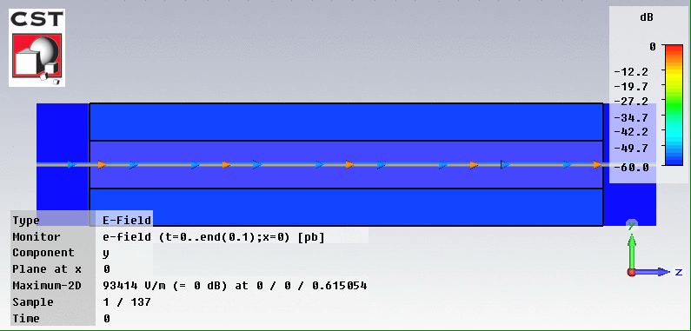
Examples of wakes/impedances
Ferrite kicker: simple model
  Evolution of the the vertical electric field (E_{y}) in the kicker while and after the beam has passed

Slide 75
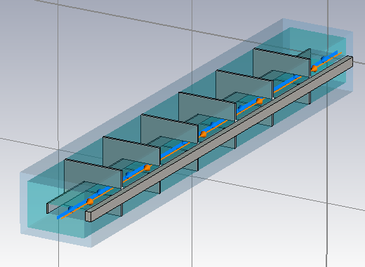
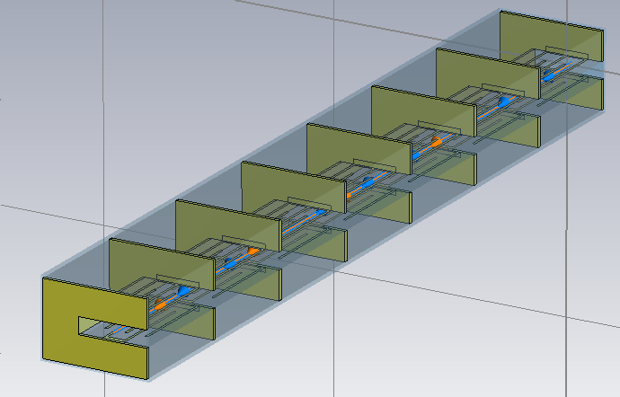
Examples of wakes/impedances
The SPS kickers
Two types of SPS extraction kickers (MKE):
Original design: several modules separated by conductor stripes (segmentation) with bare ferrite blocks, fed by an inner and an outer conductor
New design: like original, but modules have ‘serigraphed’ ferrite blocks (i.e. with patterns of silver paste screen printed on the ferrite surface exposed to the beam)
Original kicker
Serigraphed kicker

Slide 76
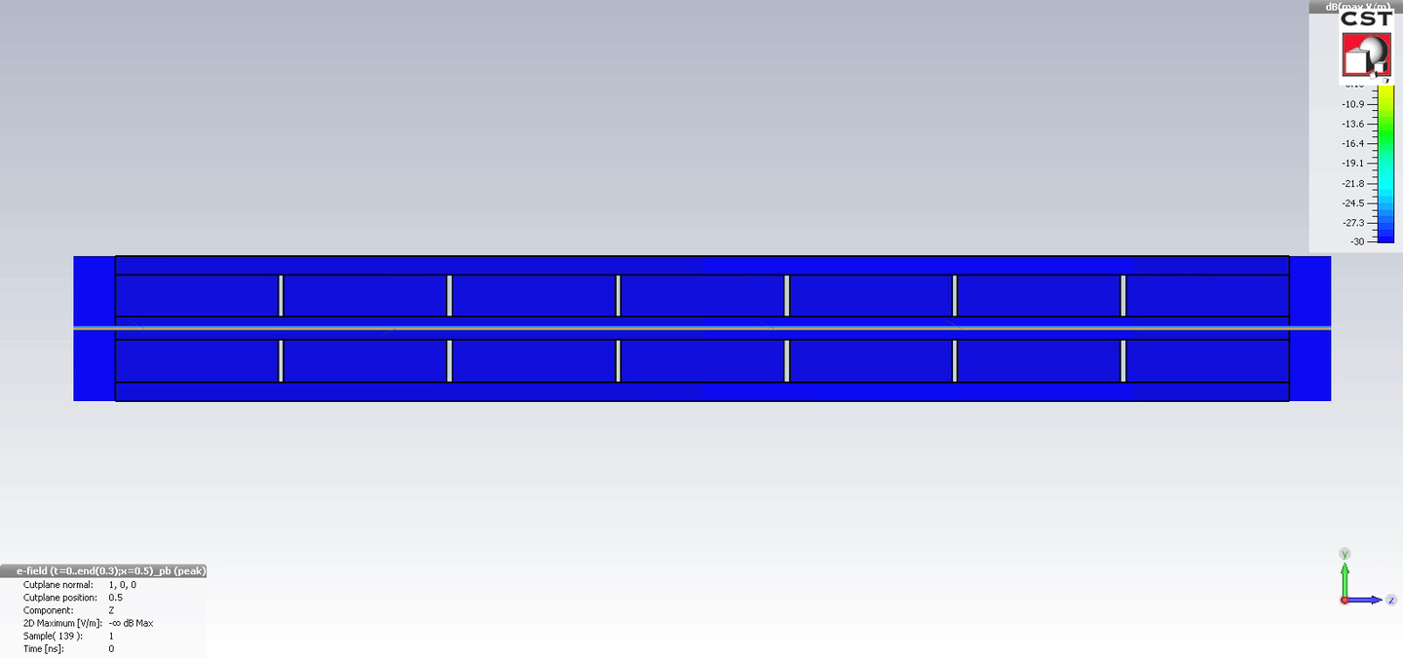
Examples of wakes/impedances
Ferrite kicker: simple model
  Original kicker without serigraphy, typical broad-band behaviour, here some ringing is due to the longitudinal segmentation

Slide 77
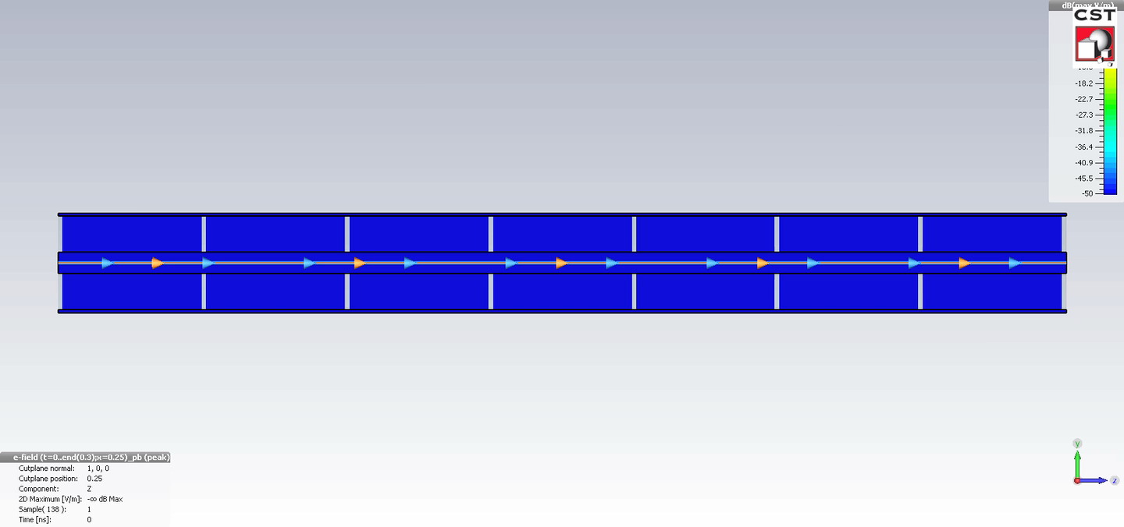
Examples of wakes/impedances
Ferrite kicker: simple model
  Serigraphed kicker exhibits strong ringing due to the EM trapping along the serigraphy fingers

Slide 78
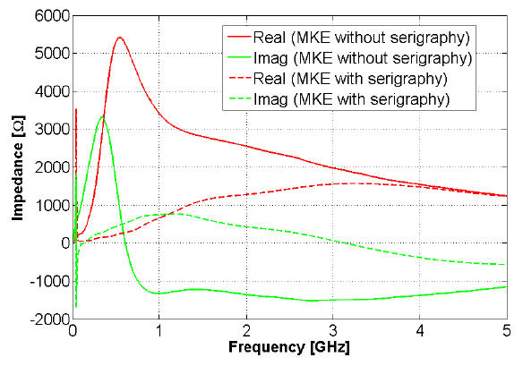
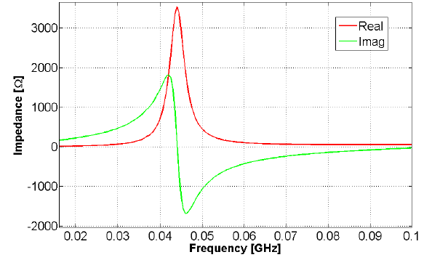
Examples of wakes/impedances
Ferrite kicker: simple model
Serigraphy
Reduces the broad-band contribution
Introduces resonance peak around 44 MHz

Slide 79
Examples of wakes/impedances
Equations of resonators

Slide 80
Examples of wakes/impedances
Equations of resonators

Slide 81

Single bunch vs. multi-bunch effects
Single bunch going through a broad-band resonator
W||
Im[Z||]
Re[Z||]

Slide 82
Single bunch vs. multi-bunch effects
Single bunch going through a broad-band resonator
W||

Slide 83
Single bunch vs. multi-bunch effects
Bunch train going through a narrow-band resonator
Re[Z||]
Im[Z||]

Slide 84
Single bunch vs. multi-bunch effects
Bunch train going through a narrow-band resonator

Slide 85
Single bunch vs. multi-bunch effects
Bunch train going through a narrow-band resonator
Δz

Slide 86
Single bunch vs. multi-bunch effects
  A short-lived wake, decaying over the length of one bunch, can only cause intra-bunch (head-tail) coupling
  It can be therefore responsible for single bunch collective effects
Re[Z||]
W||
Im[Z||]

Slide 87
Single bunch vs. multi-bunch effects
  A long-lived wake field, decaying over the length of a train of bunches, or even several turns, causes bunch-to-bunch or multi-turn coupling
  It can be therefore responsible for multi-bunch or multi-turn collective effects
Re[Z||]
W||
Im[Z||]

Slide 88
Energy loss of a bunch
(single pass, no memory)
Bunch head
Bunch tail

Slide 89
Energy loss of a bunch
(single pass, no memory)
This formula does not take into account the contribution of the wakes from previous passages in case of periodic traversals.
Therefore, it holds if:
The bunch only goes once through the wake source
The wake is sufficiently short-lived that it has fully decayed at the time of the next traversal
Bunch head
Bunch tail

Slide 90
Energy loss of a bunch
(single pass with memory)

Slide 91
Energy loss of a bunch
(single pass with memory)
This formula is more general.
It still calculates the energy loss for single pass but taking into account the contribution of the wakes from previous passages in case of periodic traversals.
In the case of a circular machine, this formula expresses the bunch energy loss per turn

Slide 92
Bunch energy loss per turn and stable phase
  The RF system compensates for the energy loss by imparting a net acceleration to the bunch
  Therefore, the bunch readjusts to a new equilibrium distribution in the bucket and moves to an average synchronous angle ΔΦ_{s}
Below transition
Above transition

Slide 93
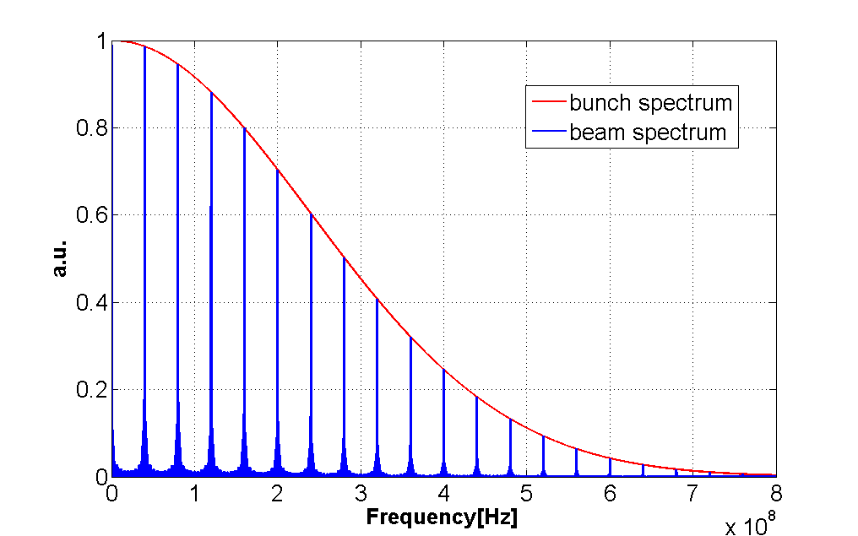
Beam energy loss per turn
Bunch spectrum
Beam spectrum

Slide 94
Beam deflection kick
Off-axis traversal of symmetric chamber
y
x
x₀
Traversal of asymmetric chamber
y
x

Slide 95
Beam deflection kick
Off-axis traversal of symmetric chamber
y
x
x₀
  The beam deflection kicks
    Are responsible for intensity dependent orbit variations
    Cause z-dependent orbits and can determine tilted equilibrium bunch distributions for long bunches
Traversal of asymmetric chamber
y
x

Slide 96
Some hints for energy loss estimations
can be calculated
1) With Z||(ω) = Z||^{Res}(ω) from slide 77 in the two limiting cases
Need to expand Re[Z||(ω)] for small ω
Need to assume |λ(ω)| constant over Re[Z||(ω)]
2) With Z||(ω) = Z_{||RW}(ω) from slide 64

Slide 97
Some applications of the energy loss
Train of bunches
  Analytical derivation
  Example 1: Heating of the SPS extraction kickers
  Example 2: Heating of the LHC beam screen
Beams with exotic bunch spacings
  The case of “doublets”
  Example: Impact in LHC, e.g. on the TDI

Slide 98
Energy loss of a train of bunches
A train of M identical equally spaced bunches circulating in a ring

Slide 99
Energy loss of a train of bunches
A train of M identical equally spaced bunches circulating in a ring

Slide 100
Energy loss of a train of bunches
  The potential leading terms in the summation are those with p = k · h, as the ratio in brackets tends to M².
  Narrow-band impedances peaked around multiples of the harmonic number of the accelerator are the most efficient to drain energy from the beam ➔ beam induced heating, instabilities.
  This type of impedances, usually associated to the RF systems and their higher order modes (HOMs), need mitigation in the accelerator design (e.g. detuners, HOM absorbers).

Slide 101
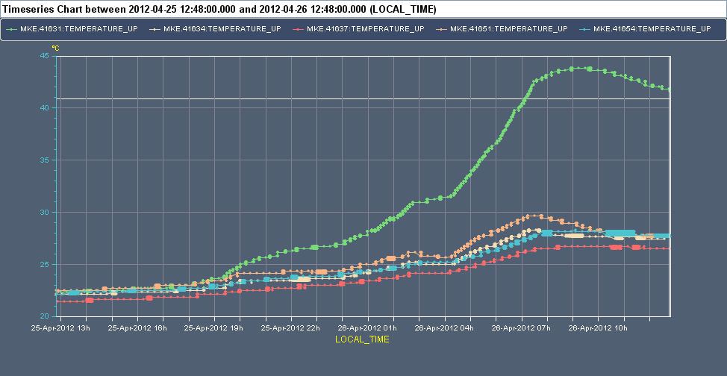
Application to the SPS extraction kickers
Running multi-bunch (25 ns) for several hours causes significant heating of these kickers
~ 17h run with 25 ns beams at 26 GeV after technical stop

Slide 102
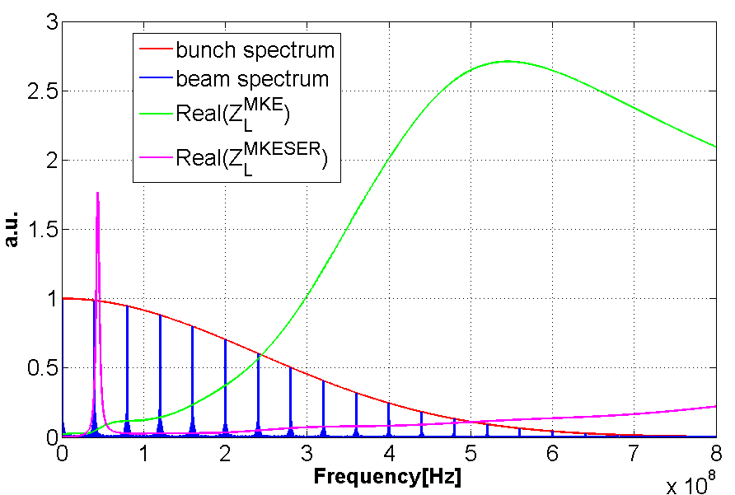
Application to the SPS extraction kickers
Z_{L}^{MKE}, Z_{L}^{MKESER}

Slide 103
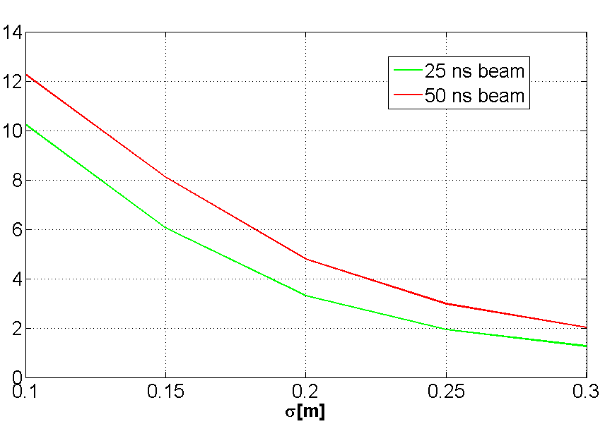
Application to the SPS extraction kickers

Slide 104
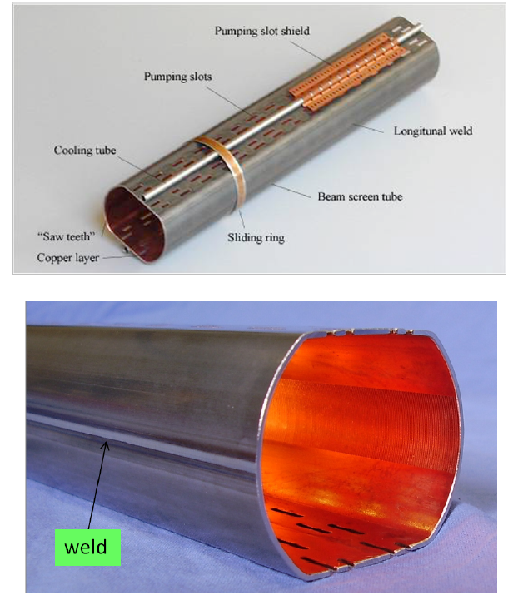
Application to the LHC beam screen
  All along the arcs and in other cold regions of the LHC, a beam screen is interposed between the beam and the cold bore
  The LHC beam screen is made of stainless steel with a layer of few μm of colaminated copper
  Due to the production procedure, there is a stainless steel weld on one side of the beam screen that remains exposed to the beam.
  The screen has holes for pumping on top and bottom

Slide 105
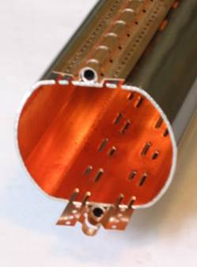
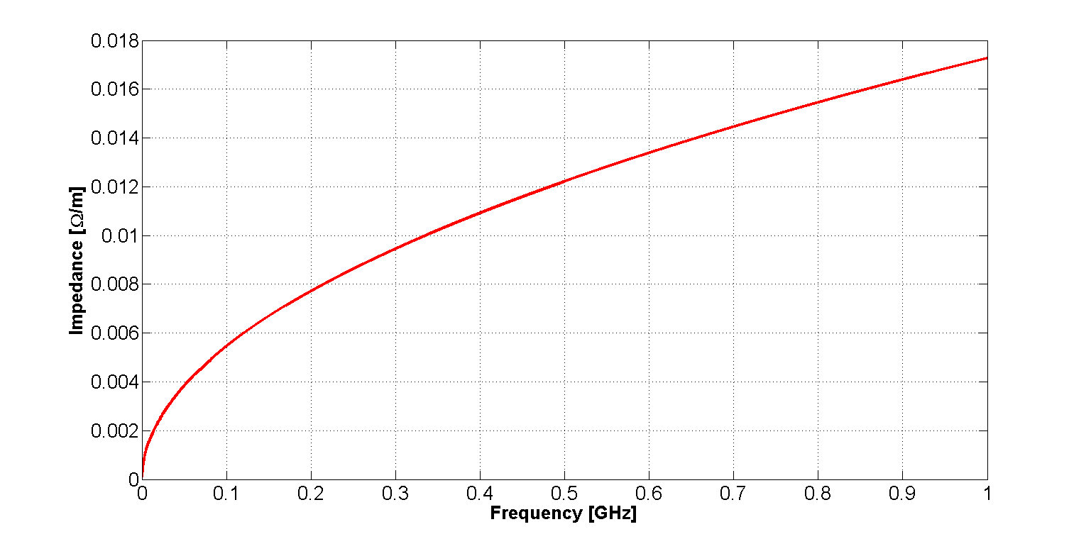
Application to the LHC beam screen
  The impedance model includes the weld on one side of the beam screen, which means a small longitudinal stripe of exposed StSt, as well as the pumping holes

Slide 106
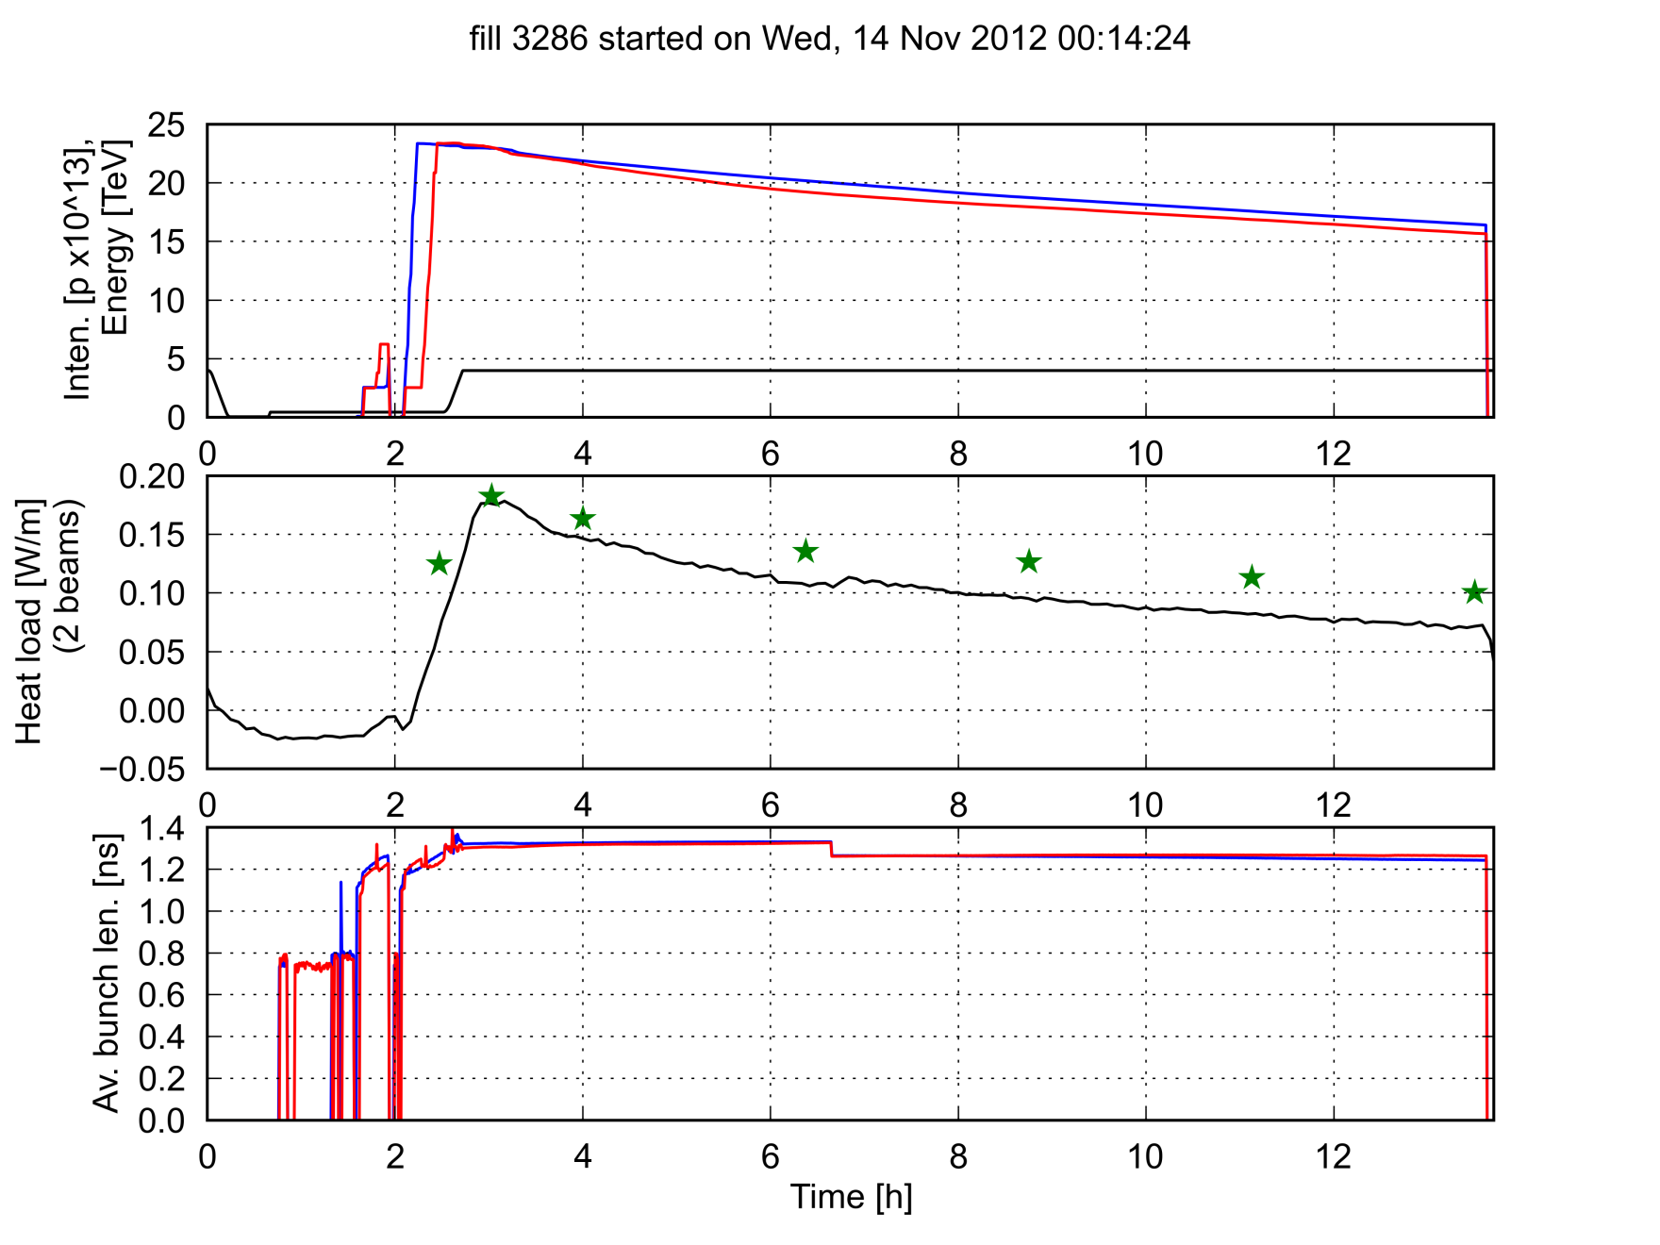
Application to the LHC beam screen
The heat dissipated on the beam screen can be calculated for a beam made of bunches spaced by 50 ns and compared to the measurement from cryogenics
50 ns
Heat load measurement from cryogenics
Estimation (impedance + synchrotron rad.)

Slide 107
Exotic bunch spacing: a “doublet” beam
N.B. in this example the doublet has double total intensity than single beam

Slide 108
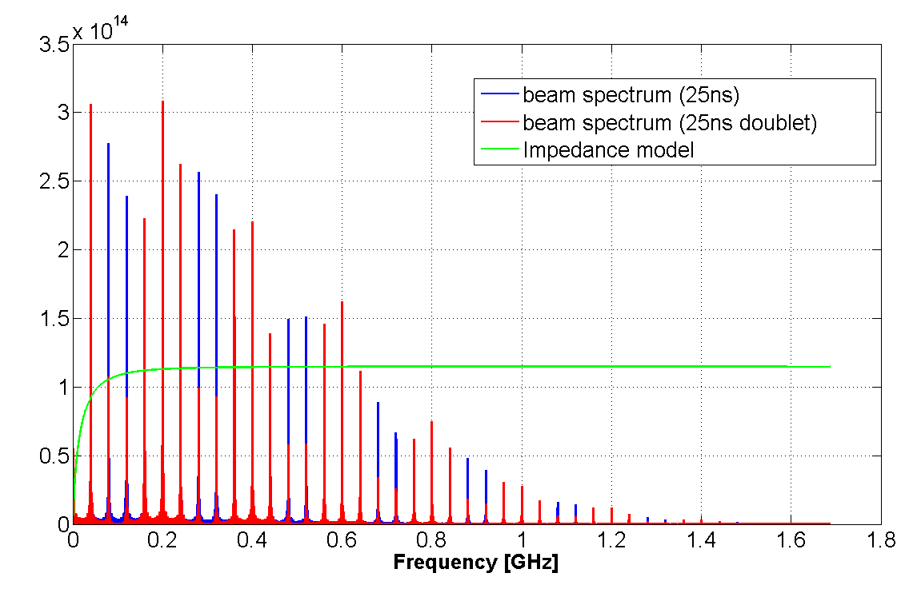
Exotic bunch spacing: a “doublet” beam
No additional impedance energy loss is expected with the doublet beam with respect to nominal beam for same total intensity
  Beam power spectrum is modulated with cos² function and lines are weakened by this modulation
  For higher doublet intensity, global effect depends on the impedance spectrum
  Example → LHC injection beam stopper (TDI)
Example for LHC beam in TDI:
25 ns (1.2 x 10¹¹ p/b) vs. 20+5 ns doublet (1.5 x 10¹¹ p/doublet )
W(25 ns) = 456 W
W(doublet) = 338 W

Slide 109
Impedance model of a machine
To build the impedance model of an accelerator it is necessary to evaluate the impedance (wake) of all the elements (analytically, numerically, through measurements)
The impedance model must then be bridged to beam dynamics studies
When studying the beam dynamics of the machine, two approaches are possible:
  Each wake is separately applied to the beam particles and the beam is transported from one element to the next one with the correct phase advance (tricky when the effect is distributed, like for the resistive wall of the vacuum chamber)
  Assuming they are a small perturbation to the beam dynamics, all the wakes are summed up and the interaction of the beam with the impedance/wake is then lumped at one location (‘kick approximation’)
    Longitudinal: The wake sum is directly used to change the momentum of all the beam particles
    Transverse (both H and V): Each wake needs to first weighted by the beta function at the location of the wake source and then the weighted sum is divided by an average beta function. The resulting wake is then applied at a location with the average beta function

Slide 110
Impedance model of a machine
The impedance model of the machine will contain therefore
  A database of impedances of the individual accelerator elements (direct source of information for approach 1. and needed for localized heating studies)
  A global wake/impedance table providing the (weighted) sum of the database elements to be used for beam dynamics following approach 2.
In general, approach 1. is in general CPU-time-wise unviable (and anyway an overkill in most cases) and approach 2. is applied
The impedance model of an accelerator is important
  At the early stage of a machine life cycle, to monitor (and steer) that the global impedance of the machine under design/construction is kept below the budget (i.e. maximum possible impedance to operate nominal beams in stable conditions)
  In operation, to study limitations and target intensity upgrades (which usually entail a program of impedance mitigation/reduction)

Slide 111
Impedance model of a machine
Z_{||1}
Z_{x1}, Z_{y1}, Z_{xQ1}, Z_{yQ1}, β_{x1}, β_{y1}
Z_{||2}
Z_{x2}, Z_{y2}, Z_{xQ2}, Z_{yQ2}, β_{x2}, β_{y2}
Ψ₁₂
Ψ₂₃
Z_{||3}
Z_{x3}, Z_{y3}, Z_{xQ3}, Z_{yQ3}, β_{x3}, β_{y3}
Ψ₃₄
Ψ₅₆
Ψ₄₅
Z_{||4}
Z_{x4}, Z_{y4}, Z_{xQ4}, Z_{yQ4}, β_{x4}, β_{y4}
Z_{||6}
Z_{x6}, Z_{y6}, Z_{xQ6}, Z_{yQ6}, β_{x6}, β_{y6}
Z_{||5}
Z_{x5}, Z_{y5}, Z_{xQ5}, Z_{yQ5}, β_{x5}, β_{y5}

Slide 112
Impedance model of a machine
Z_{||n}
Z_{xn}, Z_{yn}, Z_{xQn}, Z_{yQn}, β_{xn}, β_{yn}

Slide 113
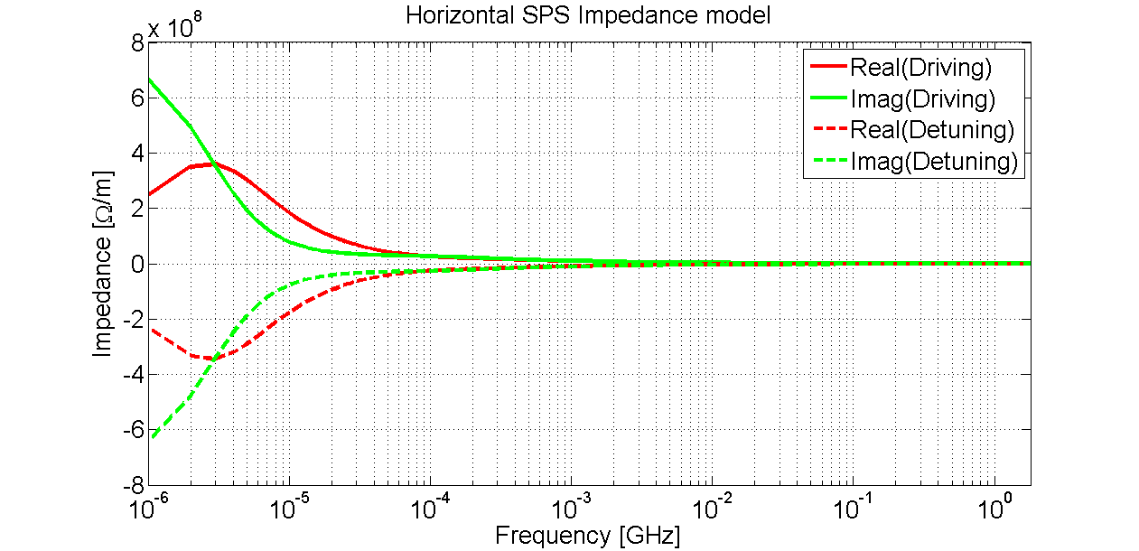
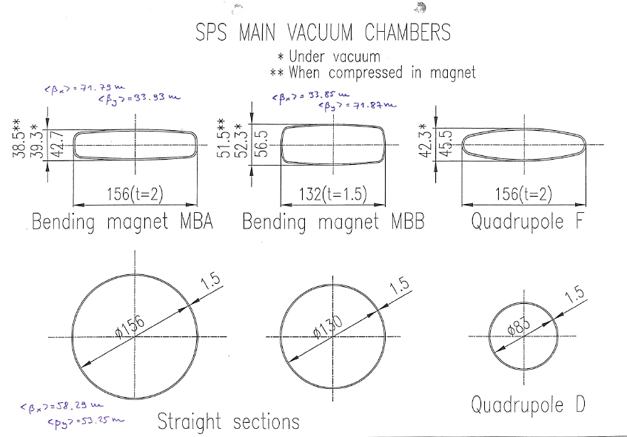
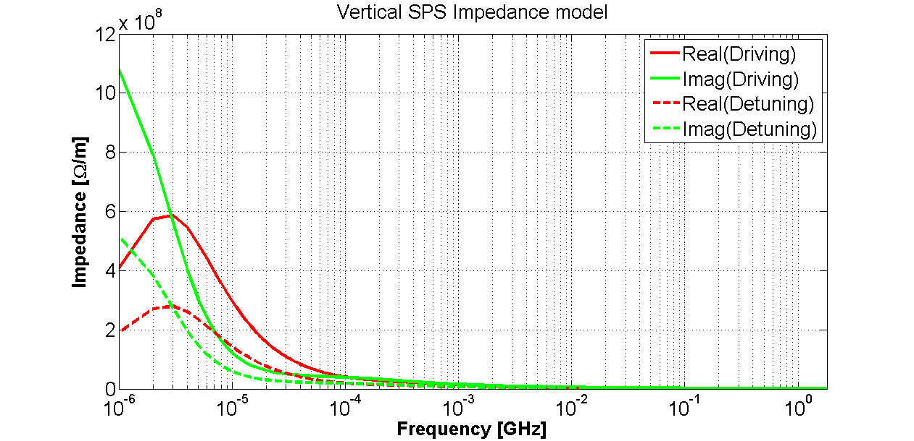
Impedance model of the SPS
The resistive wall

Slide 114
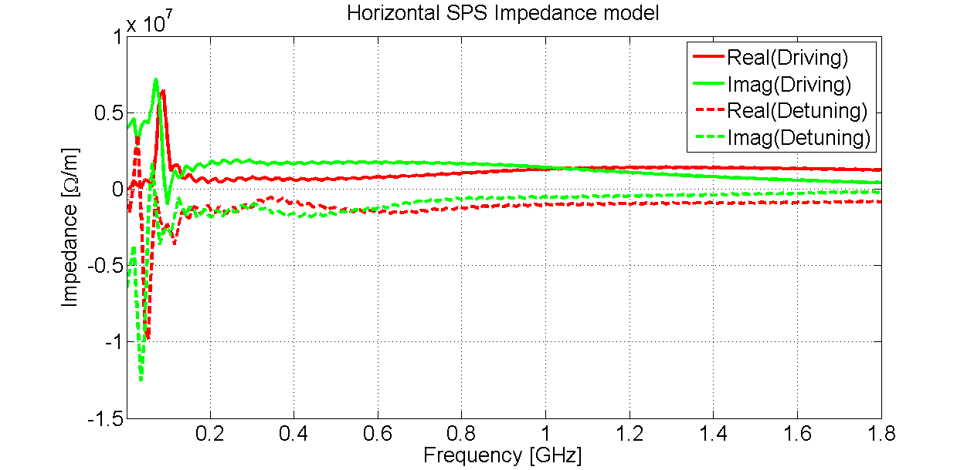
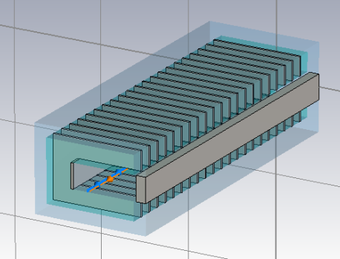
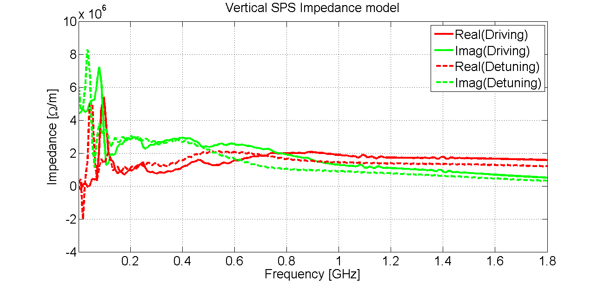
Impedance model of the SPS
The kickers
MKP
MKE

Slide 115
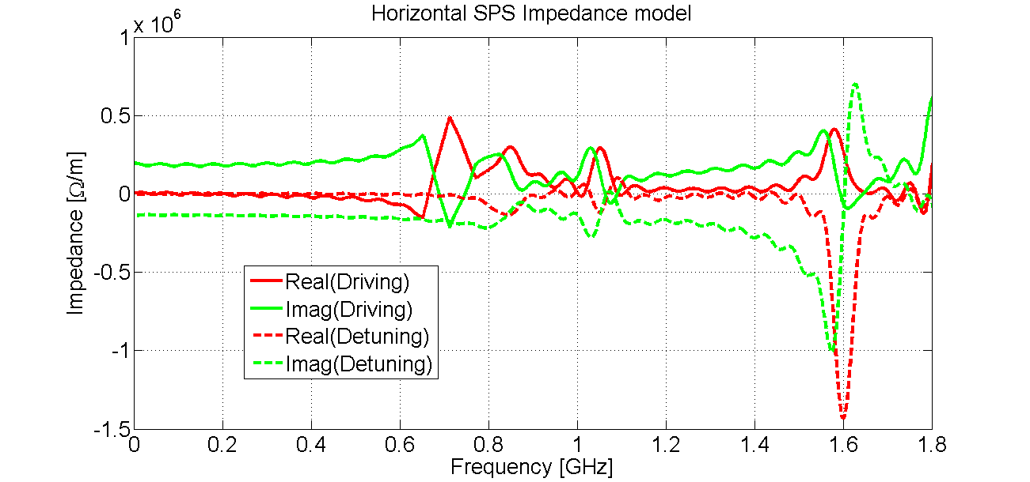
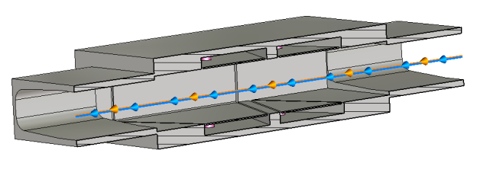
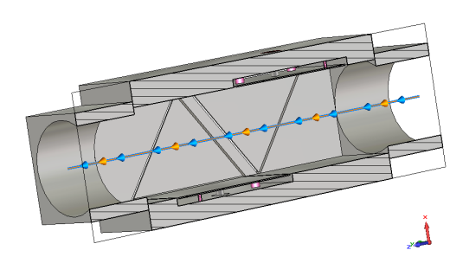
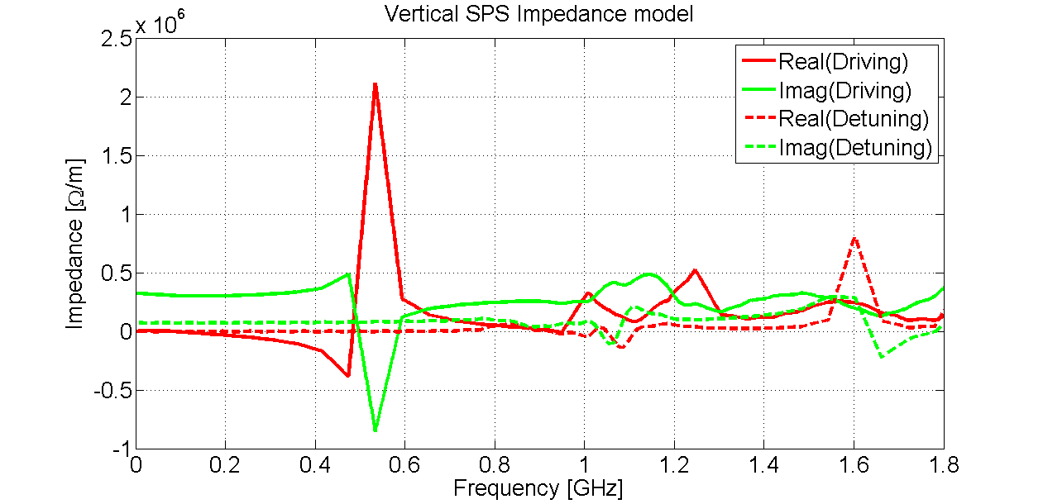
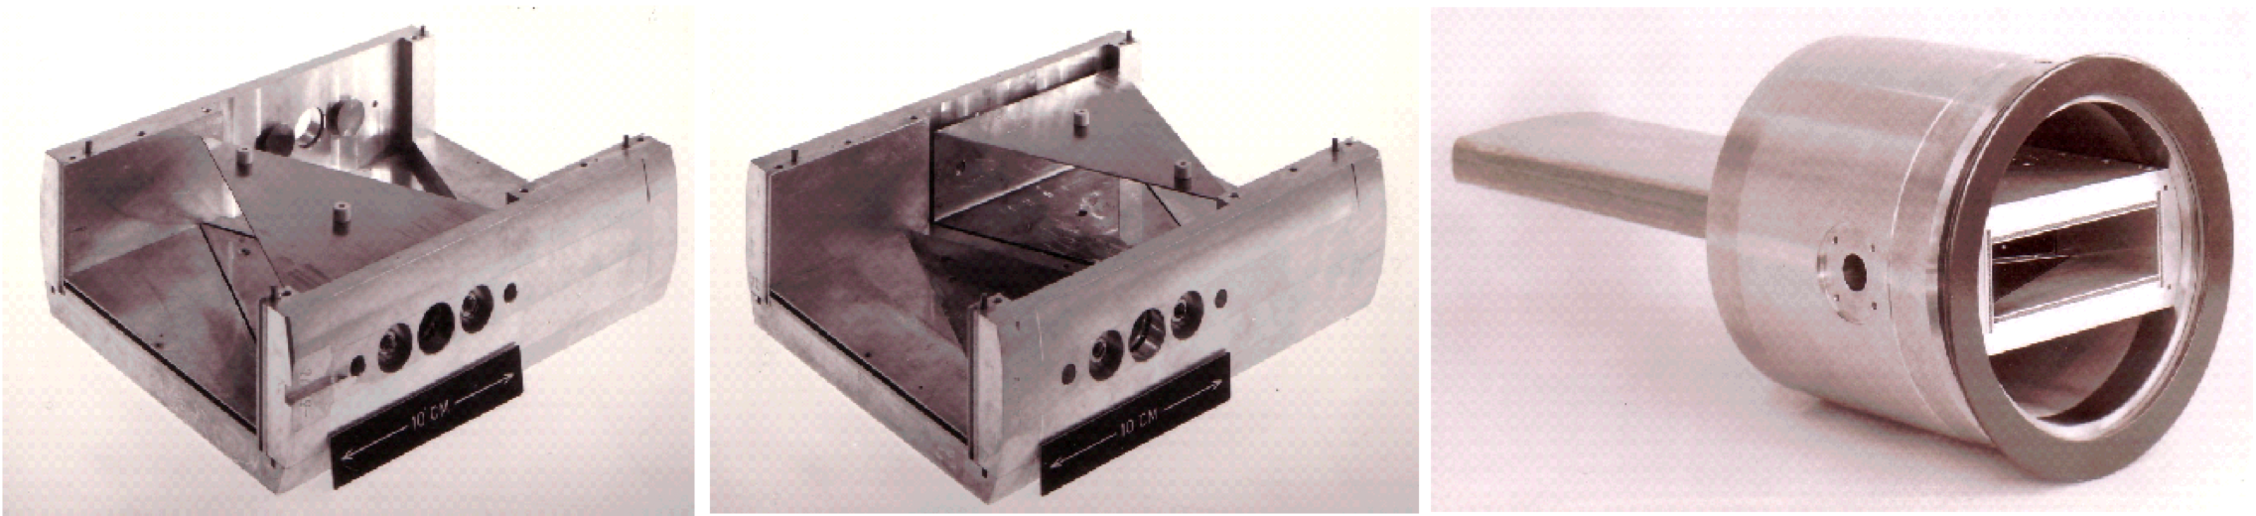
Impedance model of the SPS
The Beam Position Monitors
BPH
BPV

Slide 116
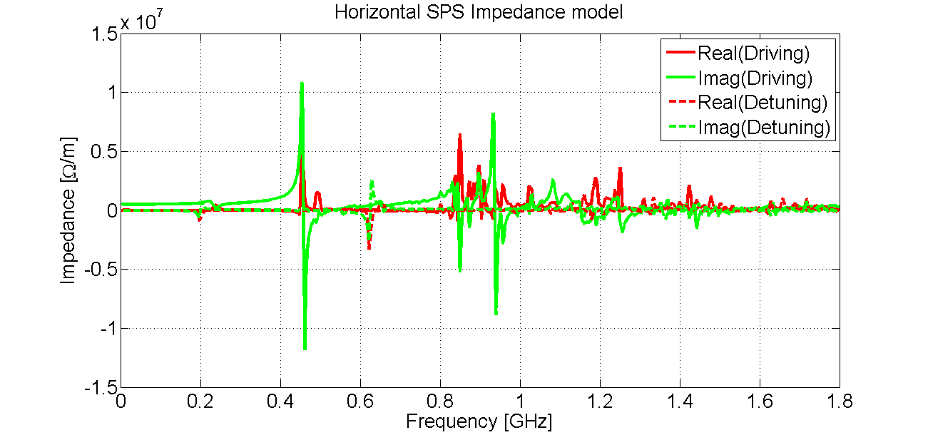
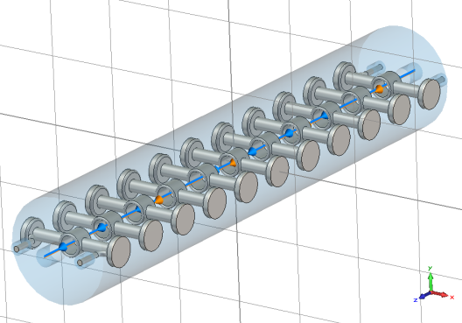
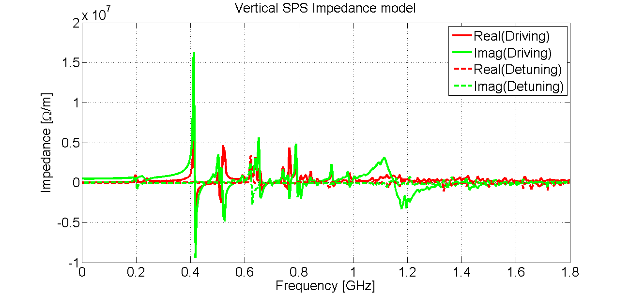
Impedance model of the SPS
The RF systems
200 and 800 MHz systems

Slide 117
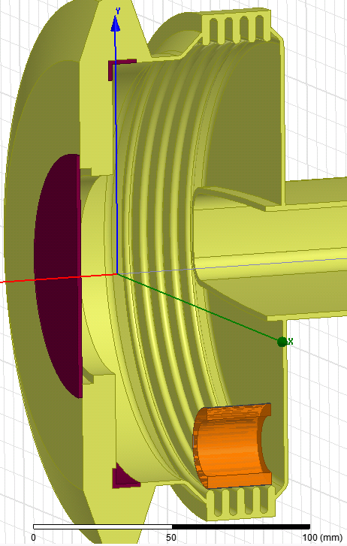
Impedance model of the SPS
Transitions
Step transitions between different types of chambers
Flange Type | Enamel | Bellow | Num. of elements | Resistor
BPV-QD | Yes | Yes | 90 | No
BPH-QF | Yes | Yes | 39 | Long
QF-MBA | Yes | Yes | 83 | Short
MBA-MBA | Yes | Yes | 14 | Short
QF-QF | No | Yes | 26 | Short
QD-QD | Yes | No | 99 | No
QF-QF | No | No | 20 | No
BPH-QF | Yes | Yes | 39 | Long
QD-QD | No | No | 75 | No
QD-QD | Yes | No | 99 | No

Slide 118
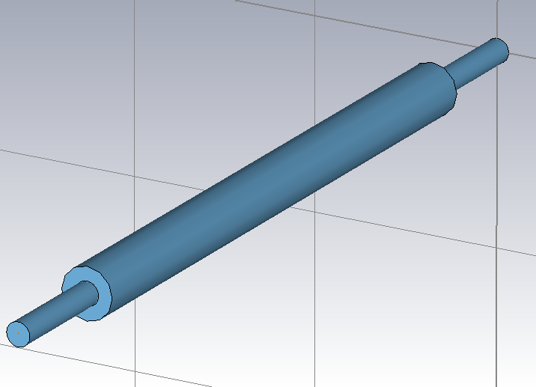
Impedance model of the SPS
Transitions
b = 17. 25 mm
d = 78 mm
Step transitions between different types of chambers
L2
since step-in and step-out have about zero real part of the transverse impedance and equal imaginary parts

Slide 119
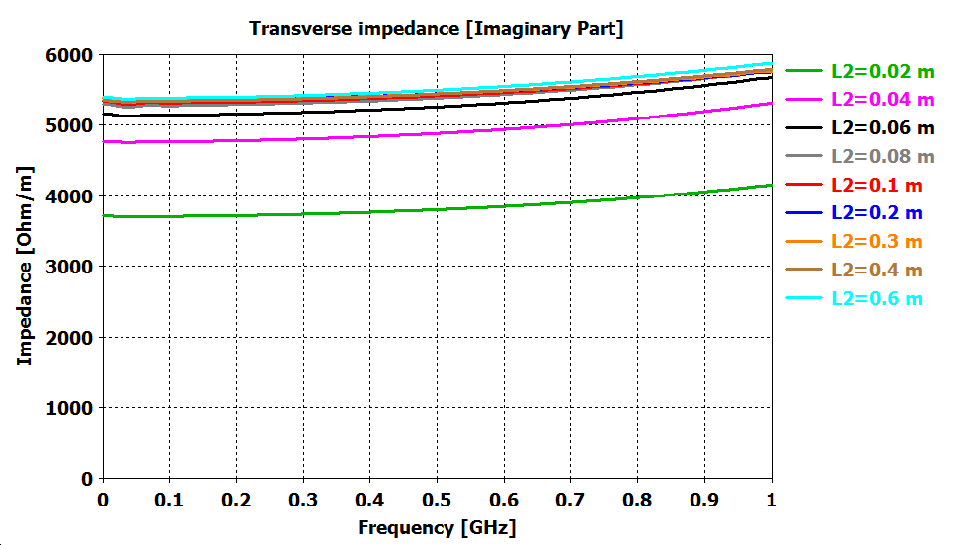
Impedance model of the SPS
Transitions
b = 17. 25 mm
d = 78 mm
Step transitions between different types of chambers
L2

Slide 120
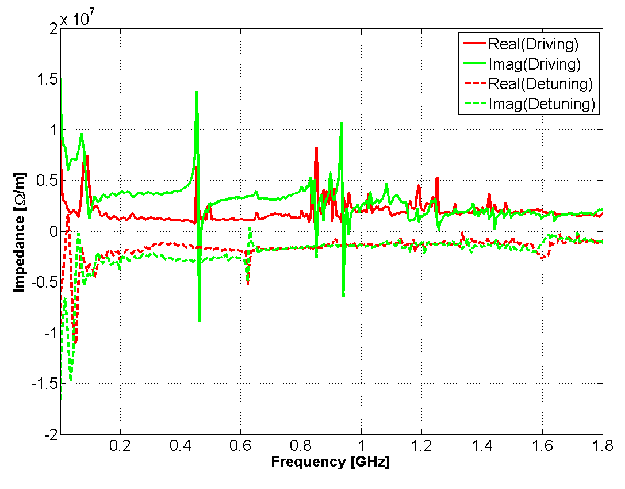
Impedance model of the SPS
Global horizontal impedance

Slide 121
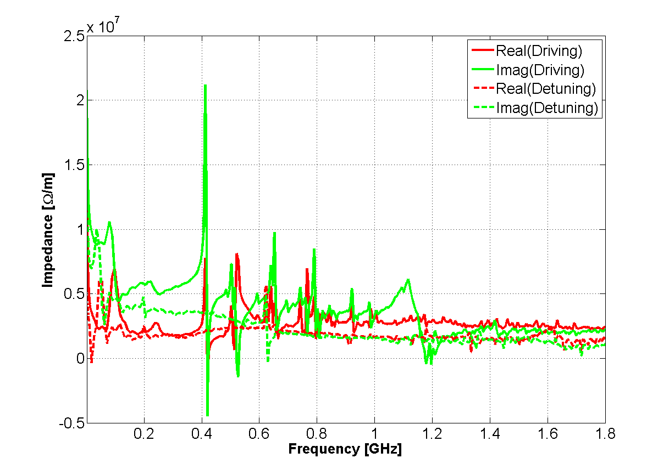
Impedance model of the SPS
Global vertical impedance

Slide 122
Summary
Definition and properties of wake functions and impedances
  Longitudinal wake and impedance
  Transverse plane: dipolar and quadrupolar wakes and impedances
  Panofsky-Wenzel theorem
Examples of wakes and impedances
  Resistive wall
  Resonators
  Complex structures
Energy loss due to longitudinal wakes
  General formulae
  Some practical examples
How to build the impedance model of a machine

Slide 123
A collider’s asymmetric common chamber
s
IP
s
y₁
y₂

Slide 124
A collider’s asymmetric common chamber
s
IP
s

Slide 125
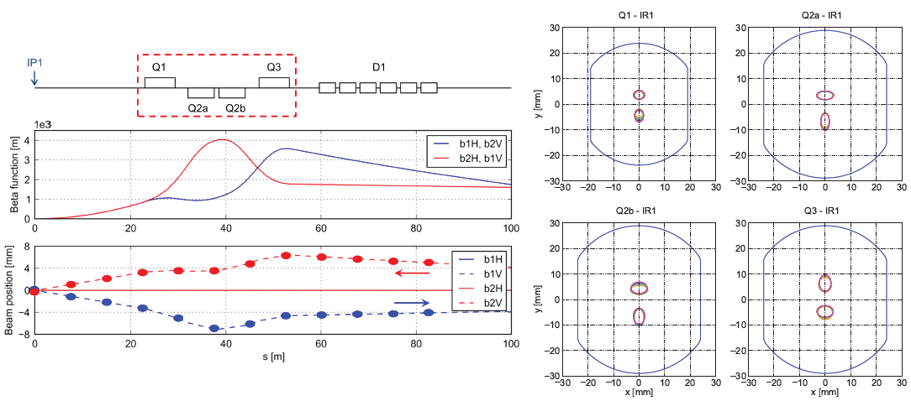
A collider’s asymmetric common chamber
Application to the LHC inner triplets
  Beams are separated vertically (IP1) or horizontally (IP5)
  Strongly off-axis for ~30m, all relative delays between beams swept
  Asymmetric chamber in the direction of separation because of the weld

Slide 126

A collider’s asymmetric common chamber
for a typical 50 ns fill of the LHC

Slide 127


A collider’s asymmetric common chamber
Estimation from impedance model
Comparison with measured data
  Estimated heat load more than a factor 10 below measurement
  Indication of a dominant contribution from something else (electron cloud), also enhanced by the two-beam effect
for a typical 50 ns fill of the LHC

